Slide 1
Savannah Neurology Specialists: Case Conference Call
June 12, 2026
Britni Johnson, AGNP-BC

Slide 2
Patient Demographics
→ 69M with 16 years education
Chief Complaint:
    Progressive cognitive decline, behavioral changes, impaired judgment, and loss of functional independence.
History of Present Illness:
    Initially referred for evaluation of progressive cognitive and functional decline.
    He presented to his initial GMN evaluation accompanied by his daughter, who reported increasing concerns regarding memory, judgment, self-care, and ability to safely live independently.
    Despite these concerns, he continued living alone and demonstrated limited insight into his deficits.
Notes:
This was a patient who presented w/a care partner who was overwhelmed. Where the diagnostic and cognitive testing was important, but the real story was what was happening at home.
Impaired Hygiene / Self-Neglect
Frequently wore dirty clothing and had poor grooming. Non-healing wounds that he needed assistance with, but home services refused care to him based on his living conditions.
Family found urine-filled soda bottles throughout the home.
Home conditions had deteriorated to the point of being considered unsafe.
Medication Management
Unable to independently manage medications.
Daughter had assumed oversight due to concerns regarding adherence and judgment.
Unsafe Firearm Access
More than 300 firearms throughout the home.
Family periodically found loaded guns lying around the house.
Ultimately required family intervention and removal of the firearms.
Impaired Judgment / Executive Dysfunction
Severe hoarding behavior with animal waste and spoiled food throughout the home.
Continued living alone and refused to sell his house despite obvious safety concerns.
Minimal insight into the severity of the situation.

Slide 3
Medical History
Medical History and Current Medications
  Liver cirrhosis (2015) secondary to chronic alcohol use disorder after death of adult son (2008)
  Hepatocellular carcinoma
  Liver transplant (2022)
  Type 2 diabetes mellitus (Sitagliptin)
  Hypertension (Metoprolol)
  Peripheral neuropathy (Gabapentin)
  Depression (Escitalopram)
  Overactive bladder (Oxybutynin)
  Obstructive sleep apnea with longstanding CPAP non-compliance
  Remote history of traumatic brain injury (recurring concussions with football)
  Atrial fibrillation and vascular risk factors noted during workup

Slide 4
Additional History
Family History:
Unknown. Patient was adopted and family history of dementia could not be determined.
Social History:
Lifelong heavy alcohol use. Following the death of his son in 2008, alcohol consumption escalated significantly, ultimately resulting in cirrhosis, liver cancer, and liver transplantation in 2022.
Lived independently for many years but recently developed significant hoarding behaviors and self-neglect. Home conditions deteriorated substantially, including: accumulation of garbage, animal waste, spoiled food, and unsafe living conditions.
Family reported increasing concerns regarding judgment (impulsive spending), hygiene (days-weeks without showering), medication adherence, and safety (initial guess ~100 guns in home, ~300 guns found)
Surgical History:
Liver transplantation (2022)
Uvulectomy for obstructive sleep apnea (1990s)
Notes:
Unfortunately, family history wasn't particularly helpful because he was adopted, so we didn't have much information regarding dementia or neurodegenerative disease in biological relatives.
The social history was really what caught my attention in this case.
He had a longstanding history of heavy alcohol use that eventually progressed to cirrhosis, hepatocellular carcinoma, and ultimately liver transplantation.
His daughter reported that alcohol use escalated significantly after the death of his son in 2008.
At the time of our initial evaluation, he was still living alone despite some pretty significant safety concerns.
The family described severe hoarding behaviors and a home environment that had become increasingly unsafe.
One of the most concerning issues was access to firearms. Family estimated there were over 100 firearms in the home, and loaded weapons had reportedly been found lying around the house.

Slide 5
Neuropsych Testing Results
MoCA, REY-O Copy, Immediate, Delayed Recall

Slide 6
Neuropsych Testing Results
TMT A, TMT B SAMPLE, PHQ-9, GAD-7

Slide 7
Diagnostic Work Up Timeline
07/28/2025
Initial evaluation with Dr. Fleenor
02/21/2026
Quest pTau217 & ApoE blood biomarkers (BBMs)
03/20/2026
FDG PET/CT scan
09/25/2025
Quest pTau217 & ApoE
10/30/2025
GMN 1 MoCA 22/30
09/02/2025
CND Syn-One skin biopsy
11/13/2025
Amyloid PET/CT scan
03/26/2026
GMN 2 clinic visit
04/15/2026
Full neuropsych evaluation
04/29/2026 GMN 3 clinic visit

Slide 8
Diagnostic Testing
Labs & Pathology Reports
09/25/2025 – Baseline labs in clinic:
  CBC: unremarkable
  CMP:
    Creatinine: 1.51 mg/dL H (Ref 0.70-1.35 mg/dL); BUN 17 mg/dL (Ref 7-25 mg/dL)
    EGFR: 50 mL/min/1.73m2 H (Ref > or = 60 mL/ min/1.73m2)
    Sodium: 134 mmol/L L (Ref 135-146 mmol/L)
  TSH: 1.70 mIU/L (Ref 0.40-4.50 mIU/L)
  B12: 351 (Ref 200-1100 pg/mL)
  Quest pTau 217: pTau217 – 0.18 pg/mL H (Ref <=0.15 pg/mL); ApoE3/3
09/02/2025 - CND Syn-One skin biopsy
  Synucleinopathy: No pathologic evidence of phosphorylated alpha-synuclein deposition within cutaneous nerves.
  Small Fiber Neuropathy: There was reduced intraepidermal nerve fiber density in a length dependent fashion. This can be seen in small fiber neuropathies, polyneuropathies and in some peripheral and central neurodegenerative disorders.
  Amyloidosis: There is no pathologic evidence of amyloid deposition in cutaneous nerves.

Slide 9
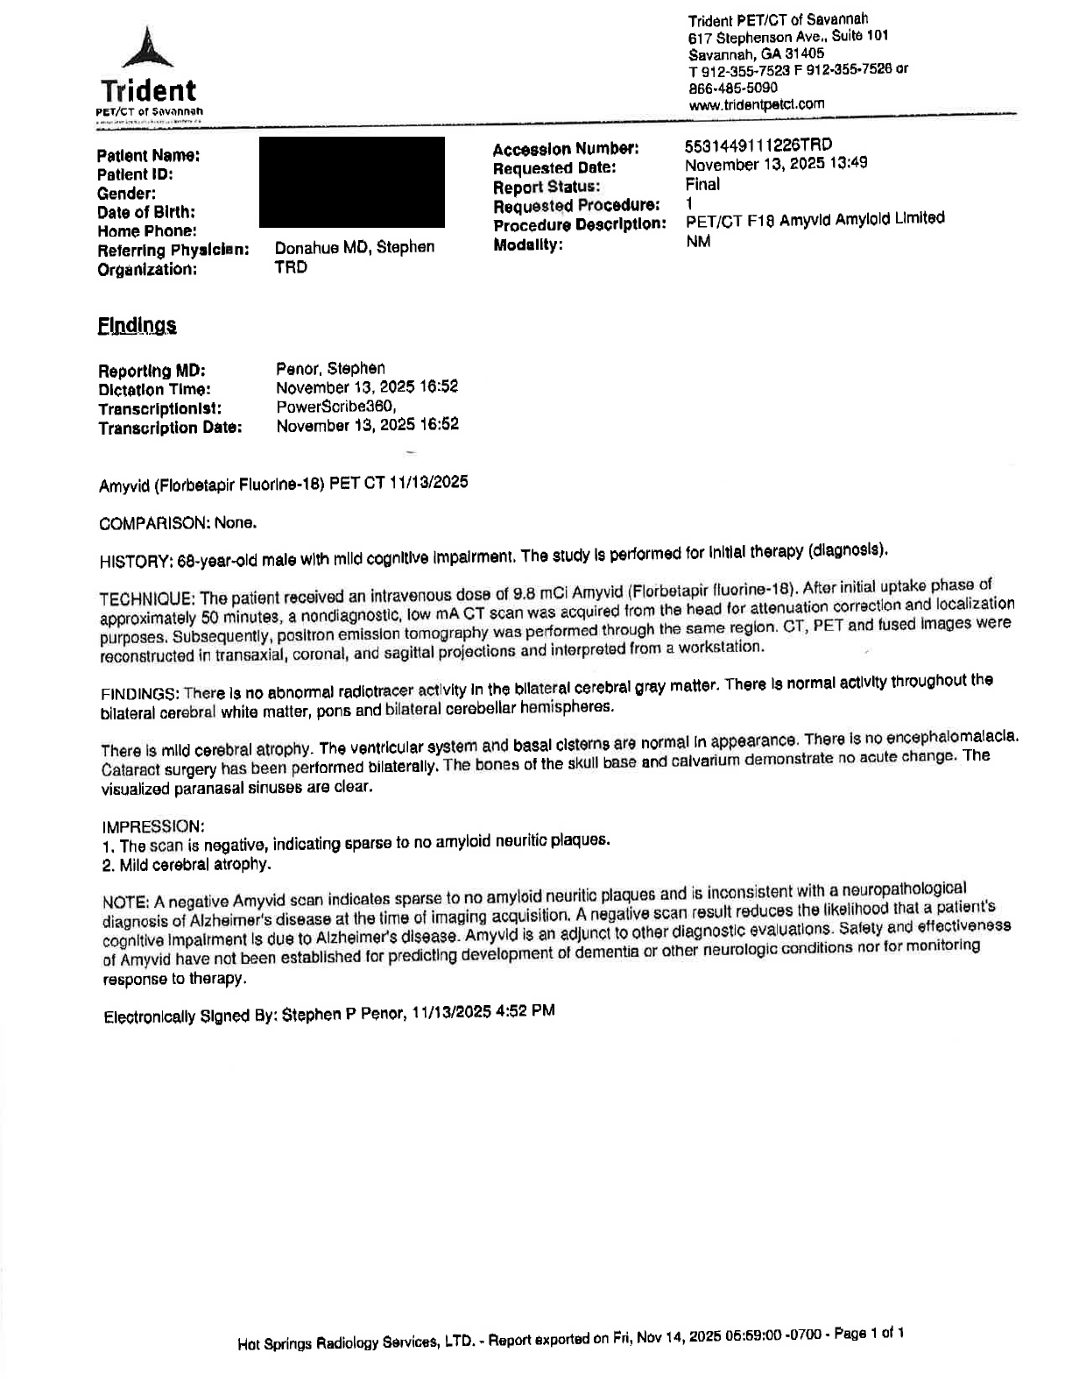
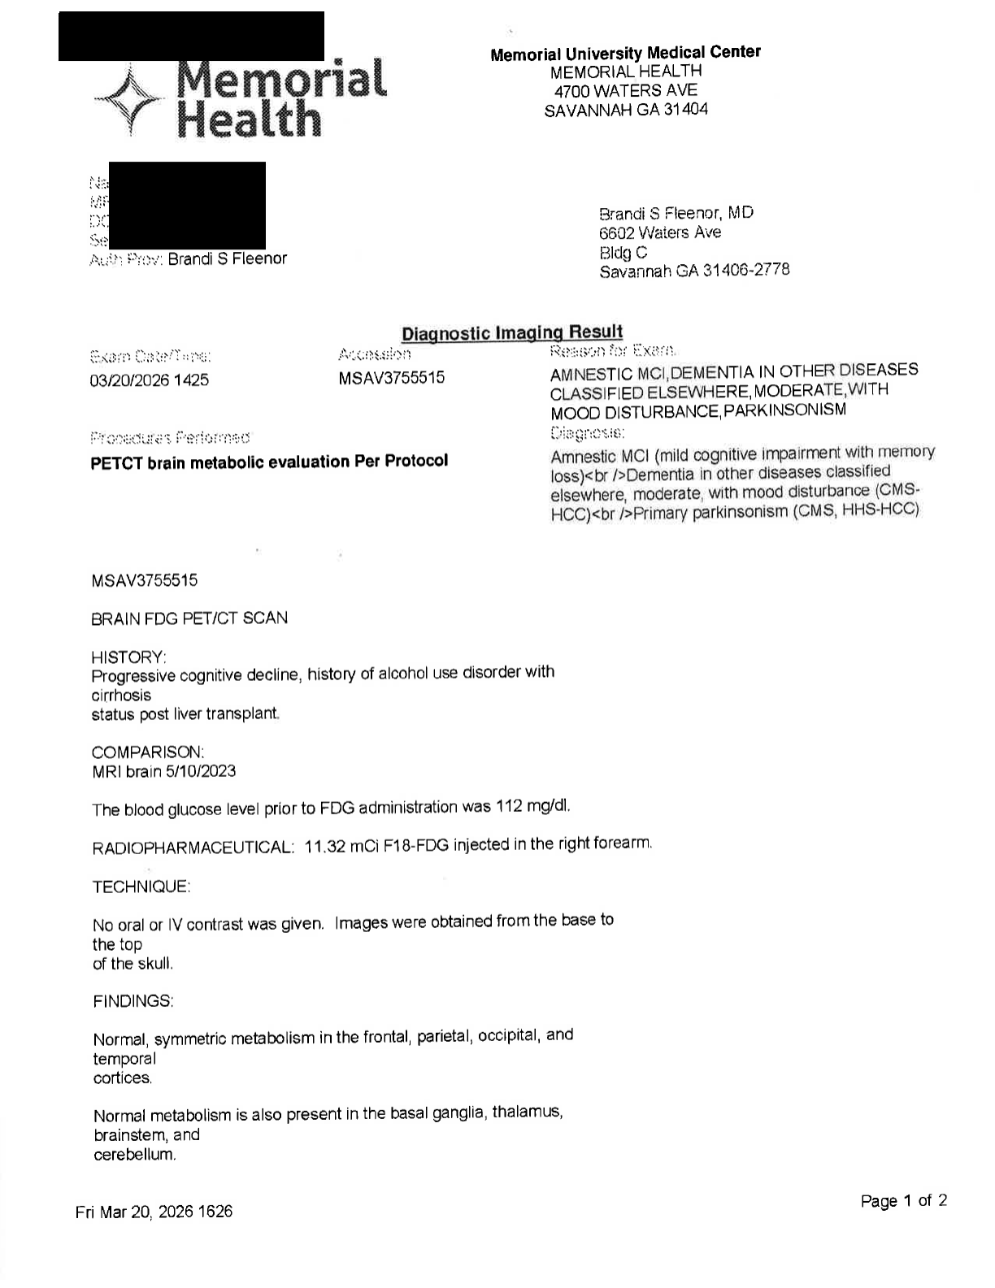
Radiology
MRI and PET CT
06/25/2025 MRI brain/brainstem w/o contrast
  No acute infarction, intracranial hemorrhage, or mass
  Moderate parenchymal atrophy
  Mild-to-moderate chronic small vessel ischemic change in the cerebral white matter
11/13/2025 Amyloid PET/CT
  Negative indicating sparse to no amyloid neuritic plaques
  Mild cerebral atrophy
03/20/2026 FDG-PET/CT
  No evidence of regional hypometabolism
  Mild global cerebral volume loss
MRI Brain

Slide 10
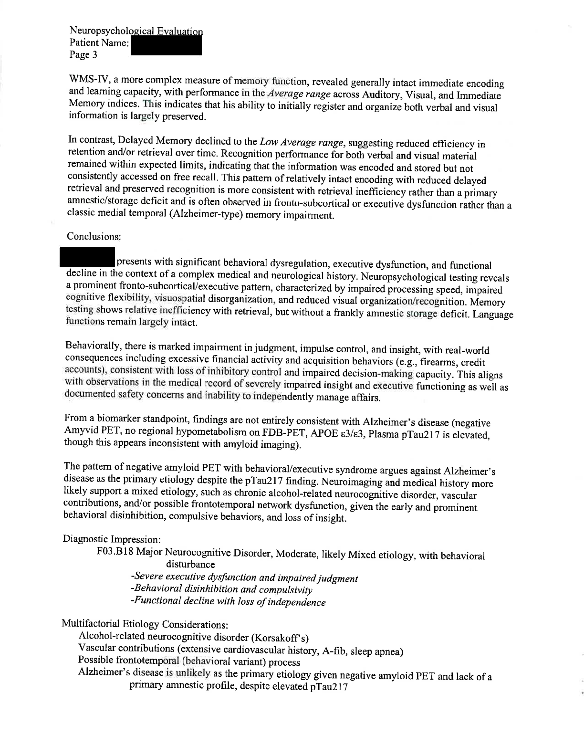
Neuropsychological Evaluation
04/15/2026 Key Neuropsychological Findings:
  Executive dysfunction was the dominant finding, particularly involving judgment, planning, processing speed, and cognitive flexibility.
  Memory was not the primary issue, with preserved recognition and retention arguing against a classic amnestic presentation.
  Behavioral symptoms—including poor insight, impulsivity, and compulsive behaviors—were prominent and contributed substantially to loss of independence.
  The overall profile was felt to be more consistent with a mixed non-Alzheimer's process than typical Alzheimer's disease.
  Final impression: Moderate major neurocognitive disorder, mixed etiology.

Slide 11
Possible Diagnosis
Alcohol-Related Neurocognitive Disorder
  Significant alcohol history with progression to cirrhosis, liver cancer, and transplant.
  Could many of the cognitive and behavioral changes be explained by chronic alcohol-related brain injury?
Vascular Cognitive Impairment
  Multiple vascular risk factors and moderate vascular burden on MRI.
  Could this represent a predominantly vascular process?
Behavioral Variant Frontotemporal Dementia (bvFTD)
  Behavioral symptoms were impossible to ignore poor insight, compulsive acquisition behaviors, hoarding, and impaired judgment.
  Cognitive profile was much more executive than amnestic.
Less likely atypical Alzheimer's Disease
  Elevated pTau217 initially raised concern for AD.
  However, the negative amyloid PET, normal FDG-PET, and overall clinical picture never felt like a clean fit.
Notes:
At this point in the workup, I wasn't convinced there was a single unifying diagnosis.
The alcohol history and vascular burden cannot be ignored.
At the same time, the severity of the behavioral symptoms—particularly the loss of insight, impulsive firearm purchases, hoarding, and poor judgment—raised concern for a possible frontotemporal process.
The elevated pTau217 further complicated things, but the negative amyloid PET and non-amnestic cognitive profile made Alzheimer's disease difficult to fully reconcile with the clinical picture.

Slide 12
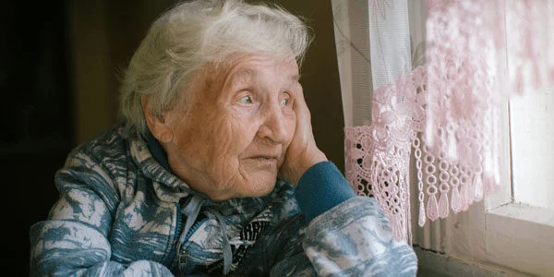
Recommendations
🧠 1. Continue Neurologic Follow-Up
  Ongoing longitudinal follow-up to monitor progression and evolving symptom pattern.
🚫 2. Maintain Safety-Focused Interventions
  Driving cessation recommended.
  Increased supervision for complex decision-making and daily functioning.
👨‍👩‍👧 3. Continue Caregiver Support
  Companion care recommended due to impaired judgment and reduced insight.
  Ongoing family involvement in finances, medications, and safety oversight.
😴 4. Address Untreated Obstructive Sleep Apnea
  Referral to Sleep Medicine/Pulmonology.
  Consider alternative treatment options given longstanding CPAP intolerance (i.e., Inspire device)
❤️ 5. Optimize Modifiable Contributors
  Continue management of vascular risk factors and overall brain health.
  Maintain alcohol abstinence.
https://blog.thebristal.com/hubfs/Imported_Blog_Media/lonely-senior-dementia.jpg
Notes:
My biggest takeaway from this case is that not every elevated pTau217 equals Alzheimer's disease. The biomarker raised the question, but the rest of the workup ultimately told a different story.
This was also a reminder that some of our most impactful interventions are not pharmacologic.
Addressing safety concerns, removing firearms, improving living conditions, and increasing caregiver involvement probably had a greater effect on this patient's day-to-day life than any medication I could have prescribed.

Slide 13
THANK YOU
&
HAPPY FRIDAY!

