Slide 1
Albany MAC: Case Conference Call
March 20, 2026

Slide 2
Patient Demographics
67 yo white female, 12 years of education
Reason for visit
Chief Complaint: progressive cognitive changes over the past year and difficulties with recall
History of Present Illness:
Onset 1-2 years ago with gradual progression, worse in the last 6 months since medications have been added.
forgets names, repetitive, word finding, forgets convos, misses appts, misplacing items, poor recall
Notes:
Our first case is a 67-year-old white female with 12 years of education and has never worked outside of the home. She was accompanied by her husband. She was referred to us for progressive cognitive changes over the past year and difficulties with recall. They reported memory and cognitive changes started 1-2 years prior and have gradually gotten worse. They especially noticed worsening in the last 6 months since medications have been added by PCP. She states that she is "having trouble remembering things that I know". She was tearful through out the visit and while describing her symptoms and concerns. She gives an example that she could not recall her sister's name recently. She is also having difficulty with repeating herself, forgetting conversations, word finding, missing appointments, misplacing things, keeping up with dates and events, and being more withdrawn. She denies any hallucinations, paranoia, or inappropriate behaviors. She reports good quality of sleep with the use of medications that have recently been added. She admits to vivid dreams but denies acting out dreams or daytime drowsiness. She reports increased depression, anxiety, and agitation. She lives with her husband and performs ADLs without difficulty. They manage the finances together and she denies making any mistakes or forgetting to pay bills. Her husband has to remind her to take her medications, and he puts her medications in a pill planner for her. She does minimal cooking and has forgotten ingredients. She has not driven since 2005 due to decreased vision related to diabetes. She reports occasionally having poor balance if she stands too fast but denies any falls. She denies appetite changes but reports slight weight loss.

Slide 3
Medical History
Medical History
Hypertension
Bradycardia
Diabetes
Neuropathy
OSA-CPAP nightly
Hyperlipidemia
Depression
CAD
MI/stent 2012
PVCs/Cardiac ablation 2019
Gout
OA
Pacemaker 2019
Chronic pain
Current Medications​​
Donepezil 5mg​​
Trulicity 0.75mg weekly​​
Cyclobenzaprine 5mg @ bedtime​​
Acetaminophen 300mg-codeine 30mg PRN​​
Metoprolol 25mg​​
Atorvastatin 40g​​
Meloxicam​​
Gabapentin 300mg @ bedtime​​
Ramipril​​
Potassium​​
Aspirin 81mg​​
Omeprazole 40mg​
Notes:
Here is her medical history and current medications. She does have significant cardiac history which includes MI with stent in 2012, cardiac ablation in 2019 and then subsequently a pacemaker later that year. Cardiac history has been stable over the last 6 years and she is monitored by cardiology. Other history includes depression, hypertension, diabetes, neuropathy, retinopathy, hyperlipidemia, gout, osteoarthritis, chronic pain, and OSA with nightly CPAP use. Her current medications include Trulicity, metoprolol, atorvastatin, meloxicam, ramipril, potassium, baby aspirin, and omeprazole. Donepezil was added prior to her referral to our clinic and they denied any improvement. Medications that had been added in the last 6 months were cyclobenzaprine 5 mg at bedtime, Tylenol with codeine as needed, and gabapentin 300 mg at bedtime.

Slide 4
Additional History
Family History
Maternal Grandfather-unspecified dementia, 50s.
Mother-unspecified dementia, early 70s.
Social History
Former tobacco use
No alcohol or drug use
Notes:
She does have a family history of dementia. Her maternal grandfather passed away in his 50s with unspecified dementia and her mother passed away in her early 70s with unspecified dementia.
She is a former smoker and denied alcohol or drug use.

Slide 5
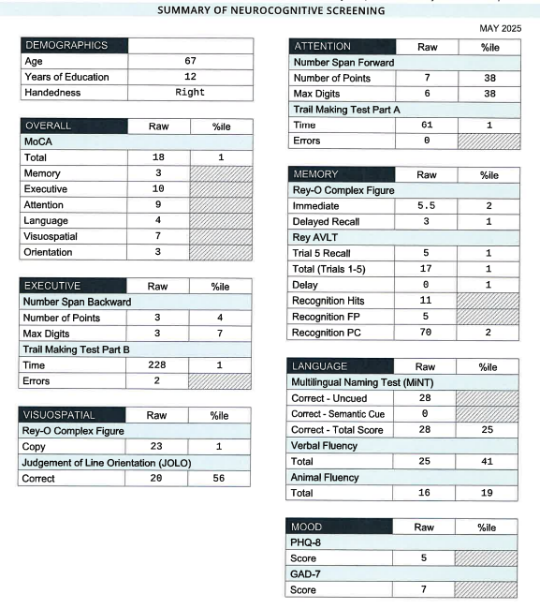
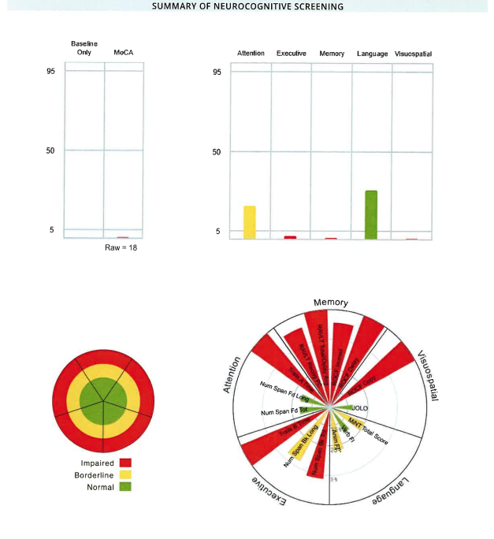
Neuropsych Testing Results
Notes:
Here are the neuropsych test results. Again, she is 67 years old with 12 years of education. She scored an 18 on MoCA. FAQ score was 7. She was able to complete the full battery of tests. She was impaired in executive, memory, and visuo-spatial domains. She was borderline in attention and normal in language. PHQ-9 score was 5. GAD-7 score was 7.

Slide 6
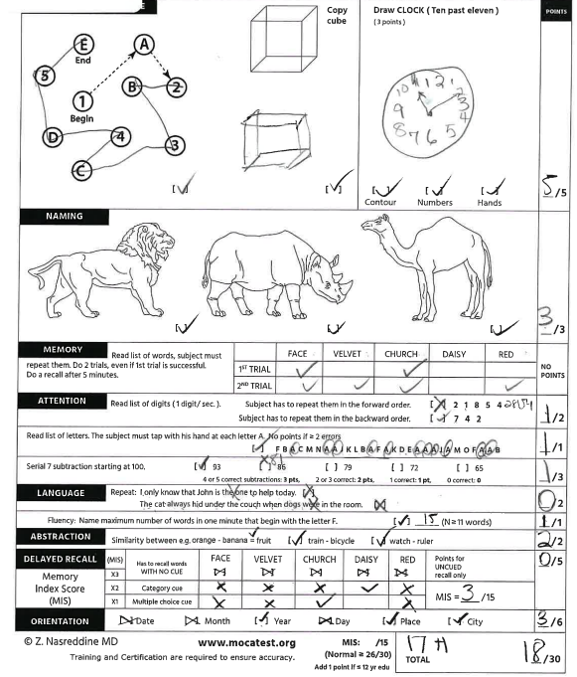


Neuropsych Testing Results
Notes:
Here is her MoCA, Rey-O copy, and Rey-O immedidate drawing

Slide 7
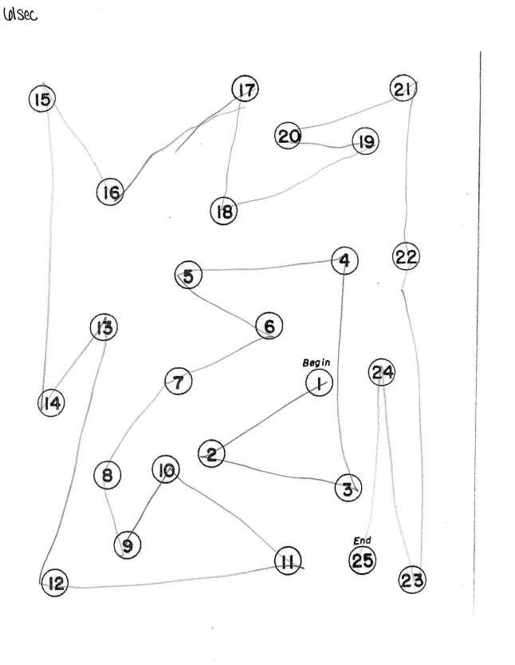
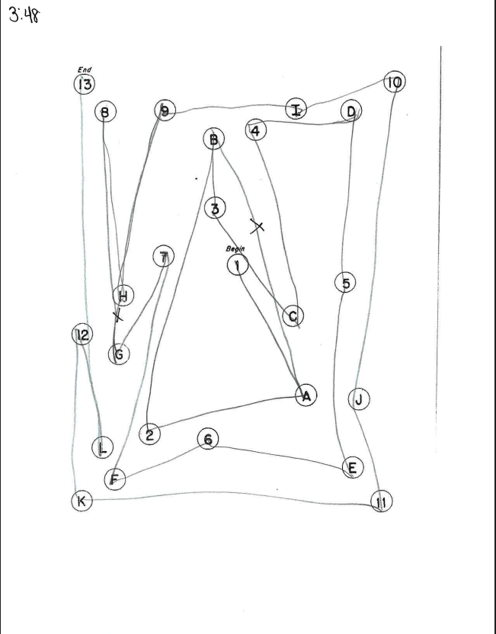
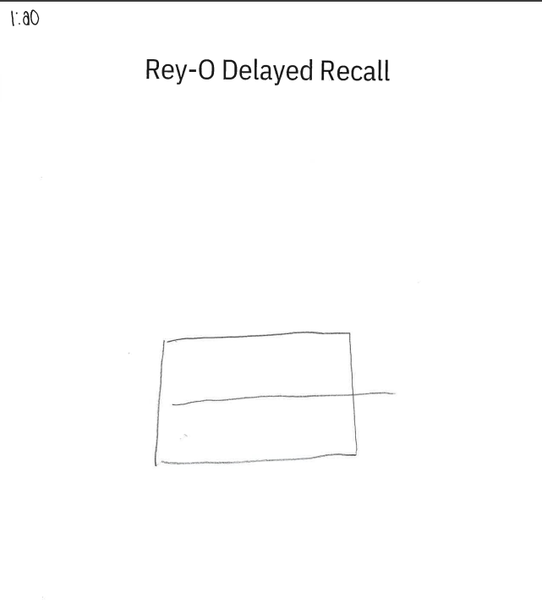
Neuropsych Testing Results
Notes:
On Trails A, she had no errors and it took 61 seconds to complete.
On Trails B, she had 2 errors and it took 3 minutes and 48 seconds to complete.
Her Rey-O delayed recall picture score dropped to only 3 points.

Slide 8

MRI
See MRI scans
Notes:
Click on Patient Name: Cookie Monster MR
MRN: PBS789
A:3= Flair images-minimal vascular changes.
A:2=T1 Sagittal MPR-
A:8=T1 Coronal
A:5=SWI-3 microhemorrhages 24, 31, 32, and questionable area on 51

Slide 9
Labs
RPR - nonreactive
TSH - 2.190
B12 - 364
Ptau217/AB42 ratio - 0.0476
Notes:
Here are her lab results. RPR was nonreactive. TSH was 2.190. B12 was 364. Blood biomarkers were positive. This is the Labcorp P tau 217 a beta 42 ratio test that was available prior to Labcorp getting the Lumipulse test. For reference, a high ratio on that biomarker test is greater than 0.0152.

Slide 10
Possible Diagnosis
AD
Polypharmacy
Anxiety
Depression
Notes:
Differential diagnoses include AD, polypharmacy, anxiety, and depression. Confirmatory testing was recommended and she did want to move forward with having an LP as we still did not have amyloid PET here in Albany at that time. I also recommended that she discuss her medications with PCP since they felt that the medications added in the last 6 months had worsened her symptoms. Lastly, I recommended that at the PCP follow up, that they also discuss treatment for anxiety and depression since she was tearful, flat, and had loss of interest.

Slide 11
LP Results
LP results
Abeta: 646.4
T-tau: 2318
P-tau: 539.5
ATI ratio: 0.22
Notes:
So she comes back for LP results and here are those results. A beta 42 was 646.4. T tau was 2318. P tau was 539.5. ATI ratio was 0.22. The test interpretation was Alzheimer's disease. However, because the a beta 42 value was just above the cutoff range and the tau levels were so elevated which significantly reduced the ratio, we decided that we would order a PET scan to confirm that there was in fact amyloid to make sure that she was appropriate for ATT. We had finally gotten amyloid PET here and she was one of our first patients that we sent for PET. She was again tearful at this visit and had not followed up with PCP yet so I started sertraline 25mg at this visit.

Slide 12
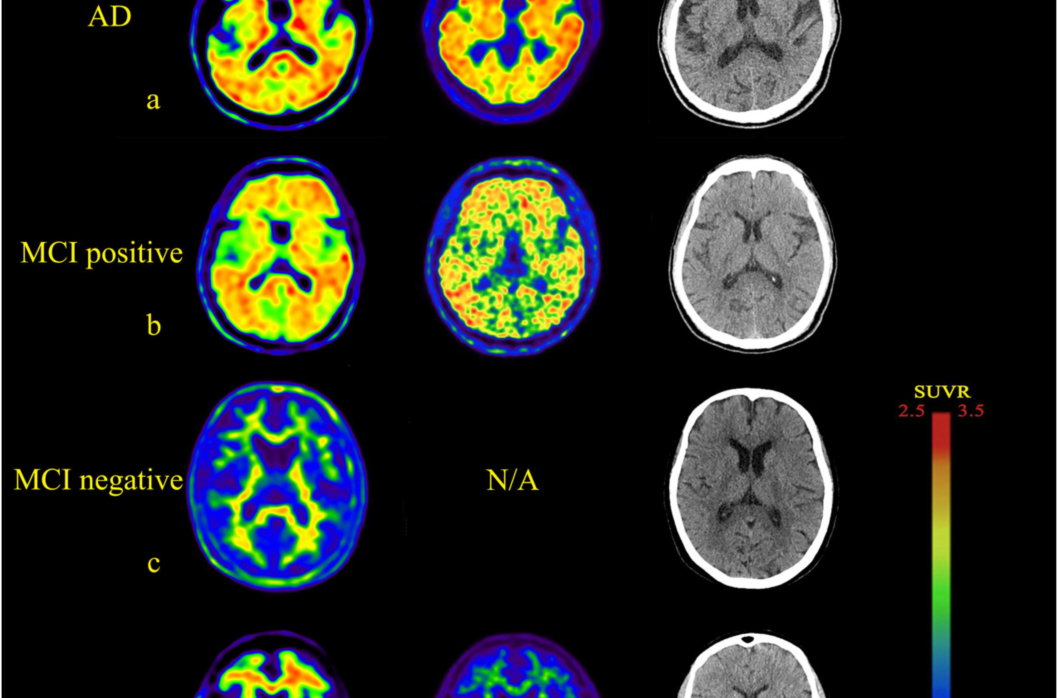
PET Scan
See amyloid PET scan.
Notes:
Click on Patient Name: Cookie Monster PT
MRN: PBS789
A:9
One moment while we switch to her PET scan images.

Slide 13
Diagnosis & Recommendation
MCI d/t AD, early onset
Referral for ATT.
Continue donepezil 10mg.
Sertraline increased to 50mg-mild improvement with 25mg.
Other meds had been optimized-reports improvement
MIND diet, physical exercise, brain exercise, social activities, daily structured routine, limit screen time, caution with meds that can worsen memory/cognition, avoid multitasking.
Notes:
Amyloid PET scan was positive. She did want to move forward with ATT. She lived over an hour from the Albany MAC so we referred her out to an infusion site that would get her a little closer to home for infusions. She was already taking donepezil 10 mg. She had been on sertraline for about 2 months by this point and she had shown mild improvement-her affect was better and she was also not as tearful at this visit. I went ahead and increased her to 50mg. They also had seen the PCP and they did optimize her medications. The patient and her husband had noticed improvement in memory and cognition following those changes. I recently spoke with her husband and she had not started infusions yet but they had seen a lot of improvement with the sertraline increase. He even stated that other people were noticing that she was participating more in conversations and was recalling information better.
So we chose to present this case because of the abnormal tau levels. To remind you, the T-tau was 2318 and the P-tau: 539.5. Any thoughts or discussion on that? Any other suggestions or concerns that any would like to make about this case?

Slide 14
Patient Demographics
70 yo black female, 12 years of education
Reason for visit
Chief Complaint: "memory challenges for the past couple of years"
History of Present Illness:
Onset 4 years ago
Repetitive, forgets conversations, paranoid, hallucinations, agitated, aggressive.
Notes:
Our next case is a 70-year-old female with 12 years of education. She retired approximately 5 years prior from Moody Airforce Base. She was referred to us by behavioral health for memory challenges for the past couple of years. She was accompanied by her daughter. During the interview, the patient denied any memory problems, hallucinations, behavior changes. She also denied any difficulty with remembering names, forgetting conversations, or misplacing things. The rest of the information obtained came from her daughter separately due to the patient's agitation. Memory changes started approximately 4 years ago which was when she was diagnosed with bipolar 1 disorder with mania. She had also been seen in the ER and diagnosed with delusional disorder and paranoia in the last year. She notes that last year, she significantly worsened and was admitted on inpatient behavioral health unit for mania. She states that her house used to be very clean and that it is now filthy. Her mom used to be very concerned with her appearance and now leaves the house with her appearance in disarray which is very unusual for her. She is constantly buying clothes and shoes-her daugher says that all of the closets are full of clothing still with price tags. Her daughter stepped in to start helping manage the finances because she was forgetting to pay bills 4 years ago but as the patient has grown more paranoid, the financial POA was revoked by her mom. Her daughter states that she is now taking out loans and has accrued a large amount of debt and calls family members for money. She believes that people are trying to harm her and that her son in law is in the illuminati. She accused her niece of stealing her clothes and became aggressive which resulted in the patient's arrest. She is also having difficulty with repeating herself, forgetting conversations, keeping appointments. Her daughter says that she only gets 3 to 4 hours of sleep per night. She has increased anxiety, agitation, and aggression. Her daughter is also worried that she will get into another physical confrontation because she is so easily angered and unfiltered, even with strangers. Last month, she was started on quetiapine 50 mg at bedtime but her daughter notes that she still has most of the pills left in the bottle so she is not taking those regularly. She lives alone and refuses to move in with her daughter. She still drives but her daughter is very concerned about her driving. She notes that there are scratches and damage around the entire car and that she calls her often because she has lost. She retired 5 years ago and was having some unknown difficulties at work. She denies any problems with balance or falls. She does have decreased appetite and weight loss. She notes that her clothes are more loose fitting and they are encouraging her to drink boost.

Slide 15
Medical History
Medical History
Glaucoma
Bipolar 1
Anxiety
Current Medications​​
Quetiapine 50mg QHS
Latanoprost 0.005%
Notes:
Medical history includes glaucoma, bipolar 1, and anxiety. Current medications that she is noncompliant with are quetiapine and latanoprost.

Slide 16
Additional History
Family History
Sister(deceased), early 80s-unspecified dementia/schizophrenia
Sister(living), early 80s-unspecified dementia
Brother(living) 79-AD
Brother(deceased), early 80s-unspecified dementia
Mother(deceased), 98-memory changes
Social History (including alcohol, drug, tobacco use)
Denies alcohol or tobacco use
Marijuana use
Notes:
She has a strong family history of dementia. Her mother had memory changes prior to passing away at age 98. Her sister passed away in her early 80s with unspecified dementia and schizophrenia. 1 sister that is still living and in her early 80s has been diagnosed with unspecified dementia. She has a brother who is living age 79 that has been diagnosed with Alzheimer's disease. And she has 1 brother that has passed away in his early 80s with unspecified dementia. She denies tobacco or alcohol use. She does have a history of marijuana use. She stated to us that she had quit smoking marijuana 1 month prior to her visit.

Slide 17
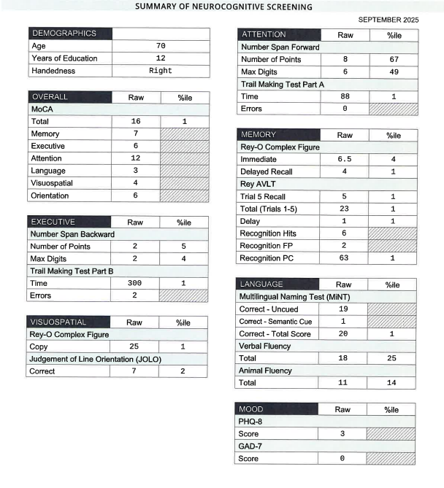
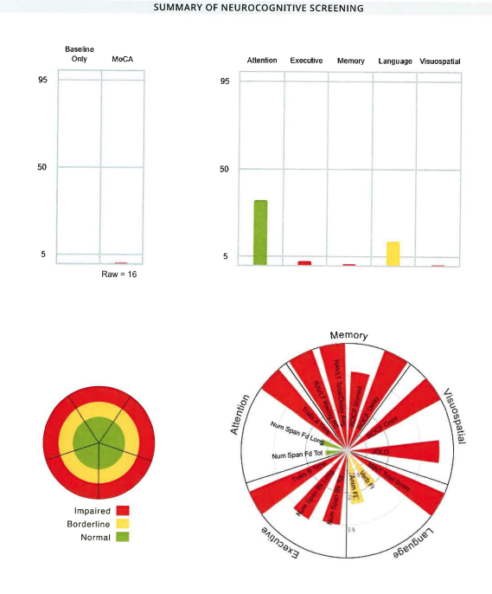
Neuropsych Testing Results
Notes:
Here are the neuropscyh test results. Again, she is 70 with 12 years of education. MoCA was 16. FAQ was 11. She was able to do the full battery which showed significant impairments in memory, executive, and visuospatial domains. Language domain was borderline and attention was normal. PHQ9 score was 3. GAD7 score was 0.

Slide 18
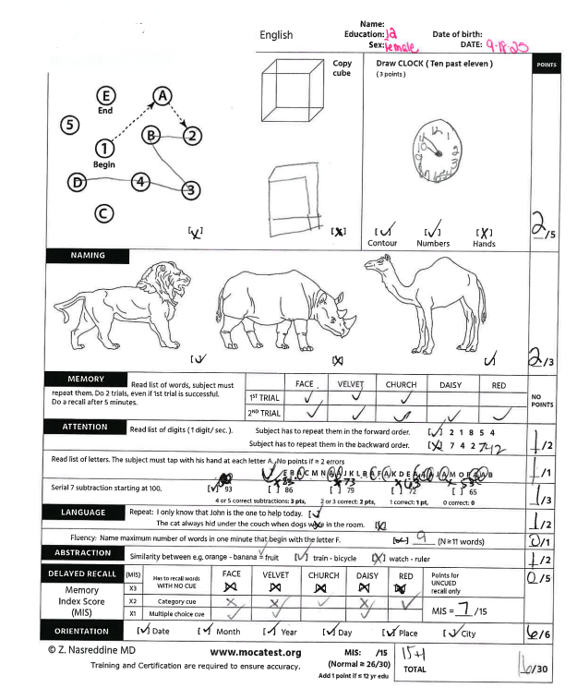
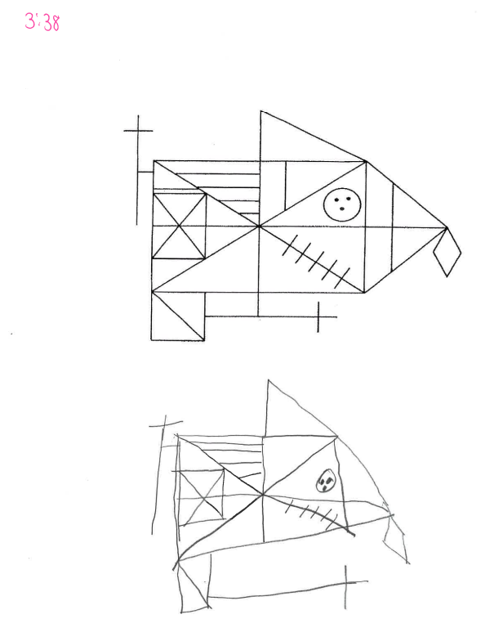
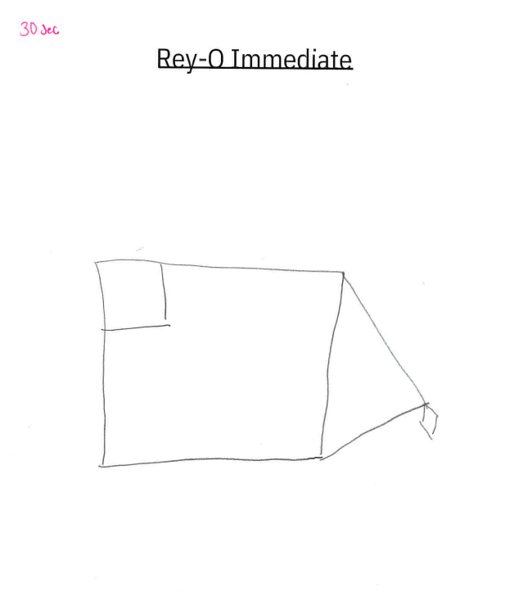
Neuropsych Testing Results
Notes:
Here is the MoCA–again that score was 16 with the extra point for education. And here is the Rey-O copy and Rey-O Immediate drawing.

Slide 19
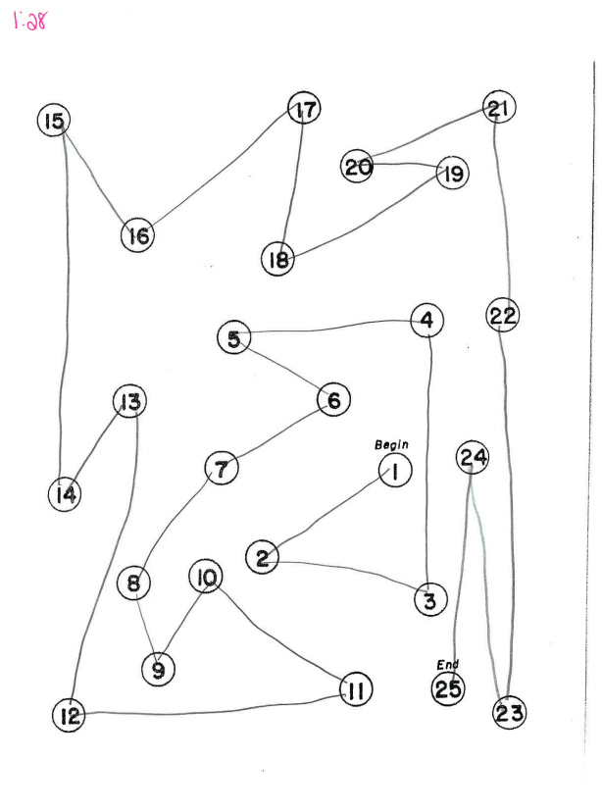
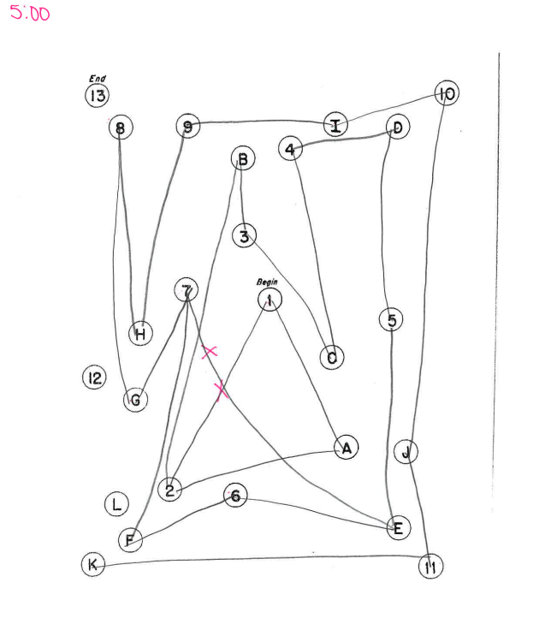

Neuropsych Testing Results
Notes:
Here is Trails A–she was able to complete it in 1 minute and 28 seconds without errors. On Trails B, she ran out of time, had 2 errors. And here is the Rey-o Delayed picture.

Slide 20
MRI
See MRI Scans
Notes:
Click on Patient Name: Big Bird MR
MRN: PBS123
A:5= Axial Flair images- Mild vascular changes, slightly asymmetric ventricles.
A:1=Sagittal T1-Volume loss
A:8=Coronal T1-
A:5=SWI-1 microhem in left cerebellum and 1 in right frontal

Slide 21
Labs
TSH - 1.35
B12 - 477
RPR - nonreactive
BBM - indeterminate
Ptau217 - 0.162
ABeta42 - 27.6
Ptau217/ABeta42 ratio - 0.00587
Notes:
Here are her lab results. TSH was 1.35. B12 was 477. RPR was nonreactive. Blood biomarkers were indeterminant. Ptau217 was 0.162, Abeta42 was 27.6, and ptau217/abeta42 ratio was 0.00587. This was the lumipulse test and for reference the intermediate range is 0.00371-0.00737 so she was right in the middle of that.

Slide 22
Possible Diagnosis
AD
Bipolar
Drug Use
Notes:
Differential diagnoses included AD, bipolar disorder, and possibly other types of drug use that she's not admitting to. We really felt that she was misdiagnosed with bipolar disorder since it is quite unusual to be diagnosed around age 65. The symptoms that behavioral health felt supported mania in bipolar disorder like no longer being concerned with the condition of her home or her appearance had never occurred prior to this. Her symptoms along with her neurocognitive battery and family history to me were more supportive of an AD diagnosis. Because her MoCA is 16, FAQ is 11, noncompliant, and possible psych, she is not a candidate for ATT.

Slide 23
Recommendation
Continue with BH
Donepezil
Continue quetiapine
Formal driving evaluation
CSE referrals
Daughters concern with drug use
Biomarkers later invalidated
Notes:
So here are our recommendations for her. She was already established with behavioral health so we recommended that she continue with them. Donepezil was discussed and her daughter did want to try it even though she is noncompliant with other medications-her daughter was going to find a way to help her be more compliant. She was also going to help her to take quetiapine as prescribed as well. I also ordered a formal driving evaluation with OT. CSC made referrals to Council on aging and Alzheimer's Association. And this last point is a pretty big social issue that we had not dealt with and some of you may have or have not encountered in your experience. But her daughter is aware that she smokes marijuana. In the first visit, the patient told us that she stopped a month prior. Her daughter knows that this is not true and here is where several major issues lie. The patient is calling and asking family members and strangers for money in order to buy it. The patient going up to and asking strangers for money obviously is a safety concern. The daughter also has extreme concern with her mother going to unsafe areas to buy drugs. There is also the added concern that she could get drugs laced with fentanyl. The daughter also does not want to feel like an enabler but feels that it may be safer to give her the money than her asking strangers or getting drugs from other people. So have you encountered this question by caregiver on how to handle an AD patient with drug use and what would you suggest? Oh and just to make things more interesting, you find out about 3 months later that the Lumipulse blood biomarkers were invalidated so what would you do in this case like draw a different biomarker or would you do anything else beings that she is not a candidate for treatment and noncompliant?

