Slide 1
Albany MAC
Case Conference Call
September 19, 2025
Jennifer Ban, FNP-C

Slide 2
Patient Demographics
76 yo white male
12 years education
Retired manager
Onset 3-5 yrs ago with progression
Difficulty remembering tasks, forgetting conversations, recalling names and words, misplacing things
Increased depression and anxiety
Widowed, lives alone
Active and travels often
Decreased appetite, no weight loss
Good sleep quality, some daytime drowsiness​
No diff with ADLs​
Occasionally forgets meds​
No diff with finances, cooking, or driving.
Notes:
Our first case is a 76-year-old white male with 12 years of education. He presents without a care partner. He was referred to us by his PCP after expressing memory concerns and wanting more information about monoclonal antibody infusions. Prior to referral to the MAC, PCP also drew Ptau 217 which was positive. PCP records state "The patient expresses interest in a new Alzheimer's treatment that involves bi-weekly infusions, which has recently become available in Albany. He is concerned about his cognitive decline and is willing to undergo the necessary tests to determine if he is a suitable candidate for the treatment. He is physically active and capable of performing tasks that many people his age cannot. However, he is worried about his cognitive decline and its impact on his ability to function independently. He is motivated to pursue treatment options to address his memory issues and prevent further deterioration."
He reports onset of memory changes approximately 3 to 5 years ago with gradual progression. He admits to having difficulty with recalling tasks, remembering names, forgetting conversations, word finding and misplacing things. He denies any difficulty with comprehension, keeping appointments, hallucinations or paranoia. He reports good quality of sleep but does endorse daytime drowsiness and occasionally takes naps. He denies vivid dreams or acting out dreams. He is widowed and does admit to increased depression and anxiety. He denies agitation.
He is retired from managing an oil company. He lives alone. He does quite a bit of traveling between his primary home in south Georgia and a cabin in north Georgia. He performs ADLs without difficulty. He manages his finances and denies forgetting to pay bills. He manages his medications with a pill planner and occasionally forgets to take doses. He still cooks and denies burning food or forgetting ingredients. He denies any confusion or accidents while driving. He does report that his balance has gotten worse and that he has to use caution. His last fall was 3 years ago. He does admit to decreased appetite but denies weight loss.

Slide 3
Medical History
PMH
Hypertension
Current Medications
Tramadol
Donepezil 10mg
Losartan/HCTZ 100/12.5mg
Potassium 10MEQ
Metoprolol 25mg
Meloxicam 15mg
Omeprazole 40mg
Levocetirizine 5mg
Atorvastatin 20mg
Hyperlipidemia
Allergies
Migraines
IBS
GERD
OA
LDD
MCI
Notes:
His medical history Includes hypertension, hyperlipidemia, migraines, IBS, GERD, osteoarthritis, degenerative disc disease, and mild cognitive impairment.
His current medications include tramadol PRN, donepezil, losartan/HCTZ, potassium, metoprolol, meloxicam, omeprazole, levocetirizine, atorvastatin.

Slide 4
Additional History
Family History
Mother-AD
3 maternal aunts-AD
Social History
Occasional alcohol use, no tobacco or drug use
Surgical History
Tonsillectomy
Right TKA 2013
Left TKA 2016
Notes:
His mother passed away at age 85 with AD. 3 of his maternal aunts passed away in their 80s with AD.
He reported occasional alcohol use and denied any past tobacco or drug use.
Surgical history includes tonsillectomy and bilateral total knee arthroplasty.

Slide 5
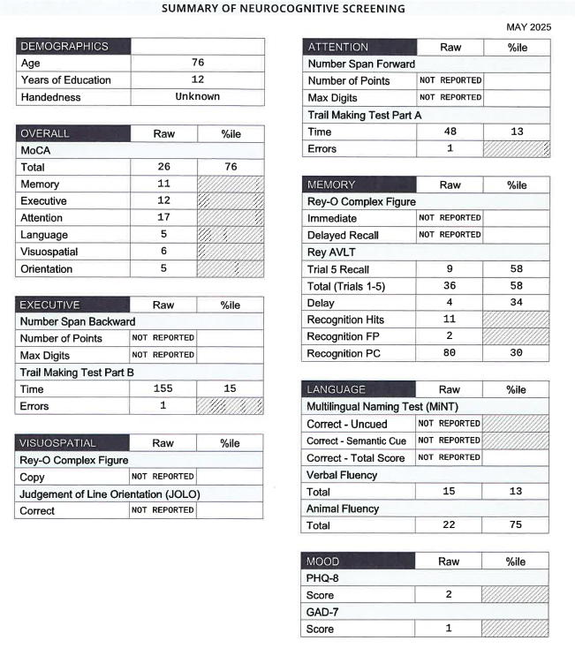
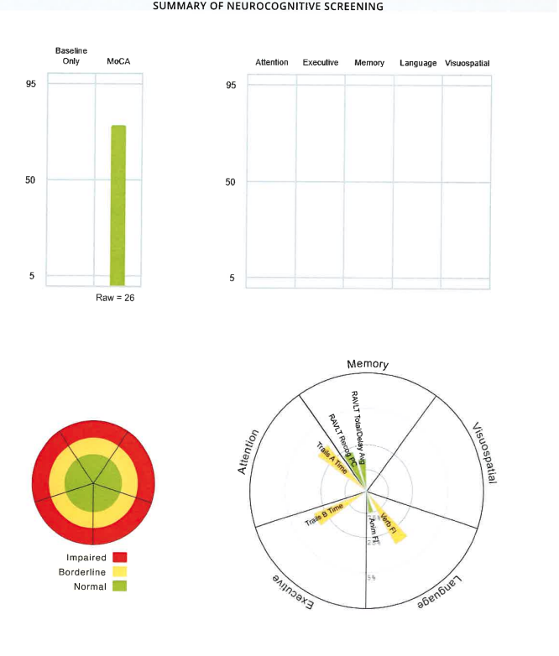
Neuropsych Testing Results
Notes:
His home was over an hour and a half from our clinic and when we called to schedule his MRI prior to his arrival, an appointment had just became available about an hour after his appointment with us. So we elected to do a shortened battery and send him to get the MRI while he was here in Albany because it can be difficult to get good scans from rural hospitals. So here are his test results. MoCA was a 26. FAQ was a 1. As you can see, there were no impairments. He did score lower on verbal fluency with 15 words. Trails A was 13th percentile, Trails B 15th percentile. He did well on ReyAVLT. He did not do number span forward or backward, Rey-o drawings, JOLO, or MINT.

Slide 6
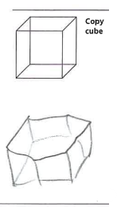
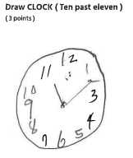
Neuropsych Testing Results
Notes:
Here is his clock and cube.

Slide 7
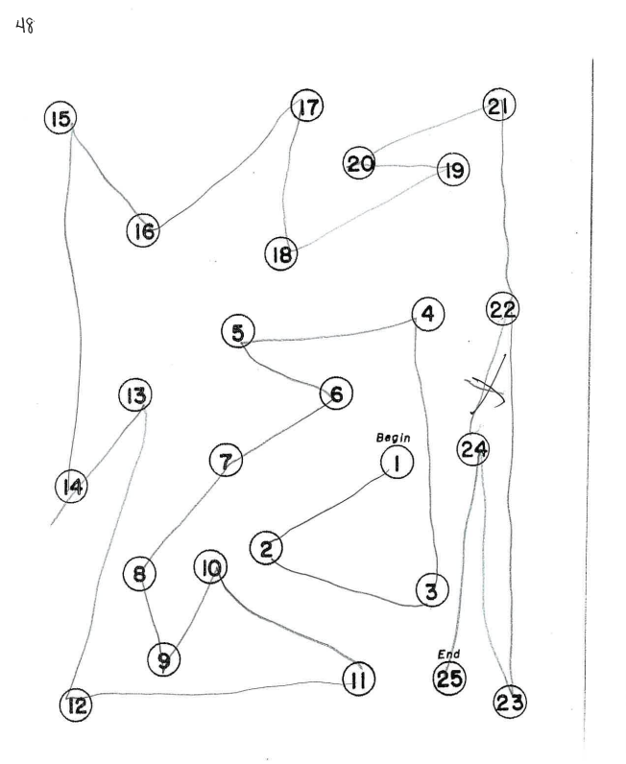
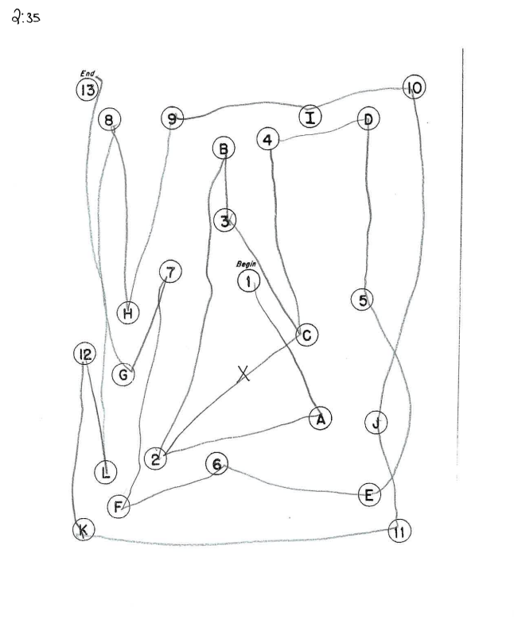
Neuropsych Testing Results
Notes:
Trails A and B

Slide 8
Labs and Screening Results
RPR-nonreactive
B12-284
TSH-1.50
Quest Ptau217-0.16
PHQ9- 2
GAD7- 1
Notes:
RPR was nonreactive, B12 284, TSH 1.50, PHQ9 score 2, GAD7 score 1, and as mentioned earlier Quest Ptau217 was positive at 0.16, for reference the cut off is 0.15.

Slide 9

MRI
See MRI scans
Notes:
Study ID – Confidential36, Ordering System Phoebe Putney
T2 Flair A:5- mild vascular changes.
Sagittal A:1- hippocampal flattening and moderate volume loss
Axial T1 A:4- a little more medial temporal lobe atrophy on the left
Coronal A:8-mild hippocampal atrophy and temporal atrophy
SWI A:6- nothing noted on SWI

Slide 10
Possible Diagnosis
Subjective memory impairment
MCI
AD
Depression
Anxiety
Notes:
Possible diagnoses include Subjective memory impairment, MCI, AD, Depression, Anxiety.
So we had his follow up visit was via telehealth and his son was present this time. We reviewed the test results and explained that on the modified test that we did, there was no objective impairment. We discussed waiting and bring him back in a year after working on lifestyle recommendations. We also discussed returning to do the full battery which could give us more information. They were not interested in either of those options because of the positive ptau217, they wanted to start infusions as soon as possible and requested referral. We were able to get more information this time since the son was not present at the initial visit and he insisted that there were changes and progression that he has also witnessed. Because he already had MCI diagnosis in his past medical history and the son corroborates progression, I felt that it might be a stretch but that we could proceed with ordering LP and he and his son were agreeable to this.

Slide 11
LP Results
LP results
  Abeta 493.45
  T-tau 440.84
  P-tau 60.5
  APOE E3/E3
Notes:
Here are his LP results.
Abeta was 493, Ttau 440, Ptau 60, APOE E3/E3.

Slide 12
Diagnosis & Recommendation
MCI d/t AD
  Referral for donanemab consult.
  Regular physical activity.
  MIND diet.
  Social activities.
  Brain exercises.
Notes:
He was diagnosed with MCI due to AD. We discussed lecanemab infusions here in Albany but he had done a lot of research and had family friend that is on donanemab. He preferred donanemab because he lives over an hour from Albany and his son lives in Macon and he was very concerned about being a burden on his son and his family as they would have to commute more often for biweekly infusions. We do not have donanemab here in Albany but Thomasville had recently started infusing donanemab there so we referred him to Thomasville.
So I would like to hear your thoughts on this case and how you might have handled it. I know many of you are having patients that are presenting with positive ptaus and normal cognition. Having the positive ptau up front really gave me tunnel vision and getting a limited battery sounded like a good idea at the time. Looking back, I think that the best plan would have been to bring him back for the full battery. The fact that they were already so convinced to have infusions also made this difficult and I'm sure that you are running into these patients as well. So in discussion, what would you have done with this scenario or do you have similar scenarios and how did you handle those?

Slide 13
Patient Demographics
76 yo white male
18 years education
Pastor, substance abuse counselor
Difficulty with remembering names, repetitive, forgetting conversations, word finding, recalling information, memory lapses
Onset 2 years ago with gradual progression, mild improvement after stopping testosterone blocker 6 months prior
  Also reports improvement on nights that he wears cpap.
Difficulty maintaining sleep, having difficulty tolerating cpap
Lives with his wife​
No difficulty with driving​
Occasionally forgets medications.​
Wife handles the cooking and finances.​
Active and works outside often on his farm and at the ranch.​
Decreased appetite, no weight changes.
Notes:
Our next case is a 75 year old white male with 18 years of education. He was accompanied by his wife. He is still working as a pastor and substance abuse counselor. He was referred to us after his AWV with PCP. At that visit, he scored a 4 on mini cog but after stating that he was worried about his memory and that he had a family history of AD, PCP chose to proceed with referral. He reports onset as approximately 2 years ago with slow progression. They did note some improvement in brain fog about 6 months prior to seeing us when he was taken off of testosterone blocker for prostate cancer so they called and canceled the appt at the MAC. But 2 weeks prior to seeing us, he was in the middle of preaching a sermon and he could not recall his thought, point, or subject. He also reported an instance when he could not find a book in the Bible which prompted them to call and reschedule his MAC appt. He is also having difficulty with remembering names, repeating himself, forgetting conversations, and word finding. He denies any difficulty with keeping appointments, misplacing things, hallucinations, personality changes, paranoia, or inappropriate behaviors. He denies difficulty initiating sleep but has difficulty maintaining and going back to sleep. He has a history of OSA and is having a lot of difficulty tolerating his CPAP mask, even after trying multiple masks. He is only able to sleep with his CPAP mask for about 1 to 2 hours and then takes it off. His wife notes that his memory and cognition is better on the nights that he is able to wear his CPAP longer. He denies increased depression, anxiety, or agitation.
He lives with his wife and performs ADLs without difficulty. His wife has always managed the finances and cooking. He manages his medications and occasionally forgets to take them. He still drives and denies any confusion or accidents. He denies regular exercise but is very active outside. He denies any problems with balance and his last fall was 1 to 2 years ago while working outdoors. He does report decreased appetite but denies weight loss.

Slide 14
Medical History
PMH
Prostate CA 2023
Current Medications
Zyrtec 10mg
OSA
Seasonal allergies
Gout
MVI
Notes:
He has a history of prostate cancer, OSA, seasonal allergies, and gout.
He currently takes zyrtec and a multivitamin daily.

Slide 15
Additional History
Family History
Social History
Surgical History
Mother-AD
No tobacco, alcohol or drug use
Seed brachytherapy
Notes:
His mother passed away at age 80 with Alzheimer's. His 73 year old sister has recently been seen here at the MAC for memory changes and is awaiting MRI.
He denies any history of tobacco, alcohol, or drug use.

Slide 16
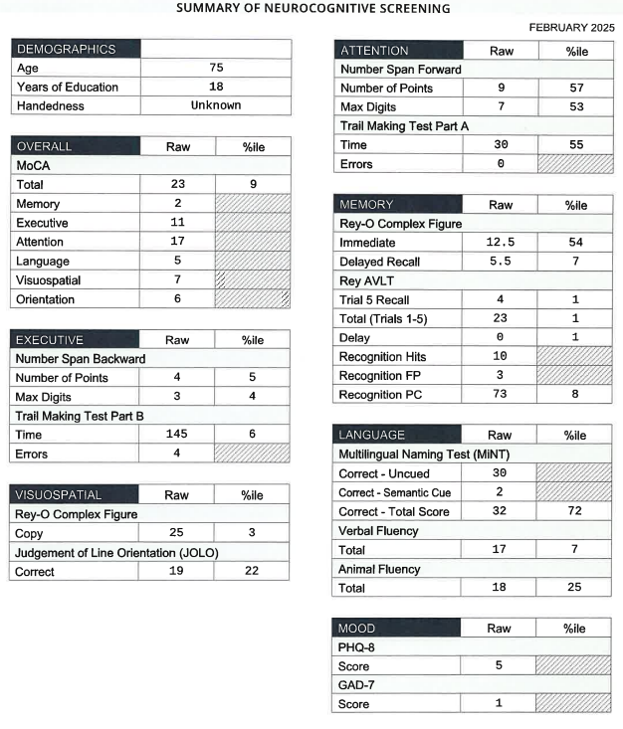
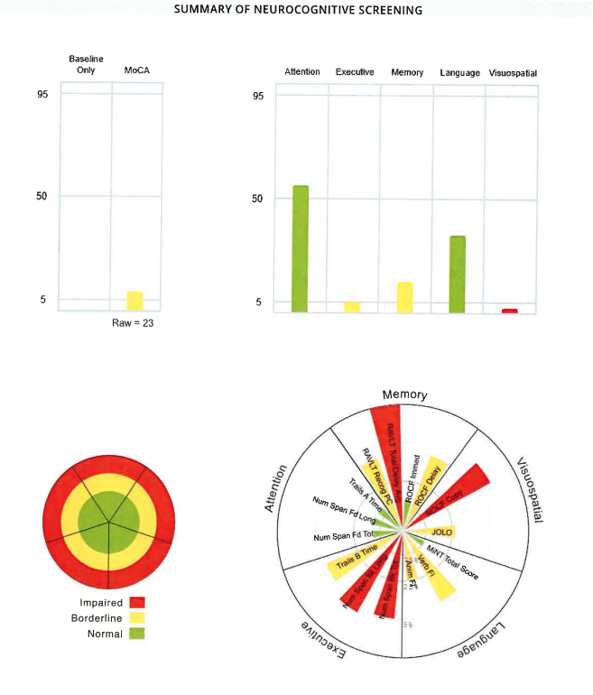
Neuropsych Testing Results
Notes:
Here are his test results. MoCA was 23, FAQ was a 1. Visuospatial domain was impaired. Memory and Executive were borderline. Attention and Language were normal. 1st percentile on the Rey recall, total, and delay.

Slide 17
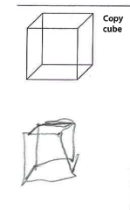
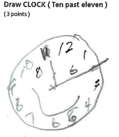
Neuropsych Testing Results
Notes:
Here is his cube and clock.

Slide 18
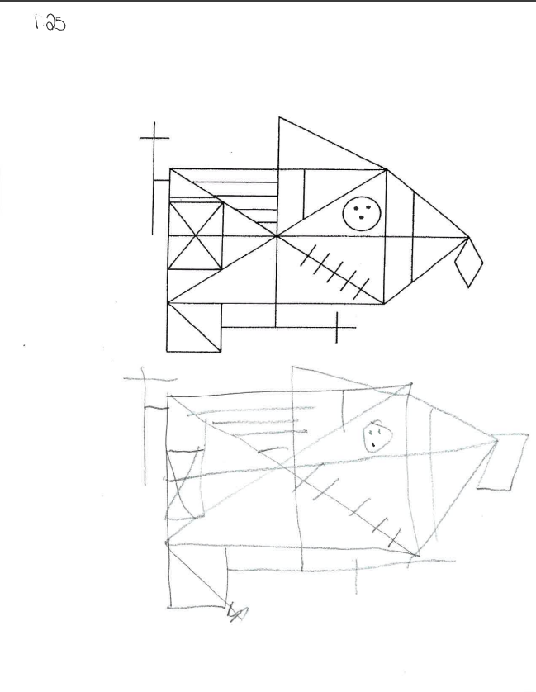

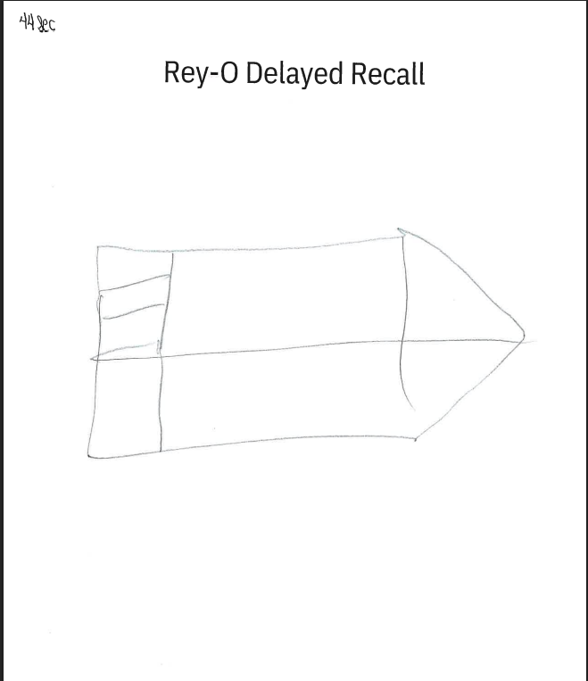
Neuropsych Testing Results
Notes:
Here are his Rey-o drawings.

Slide 19
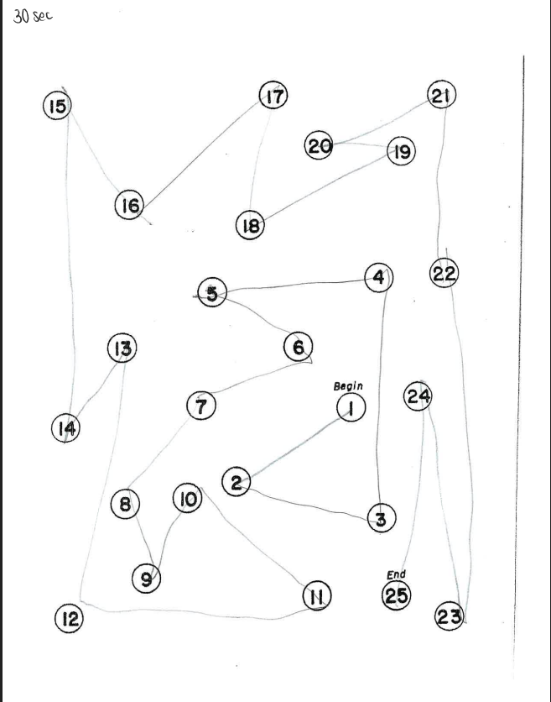
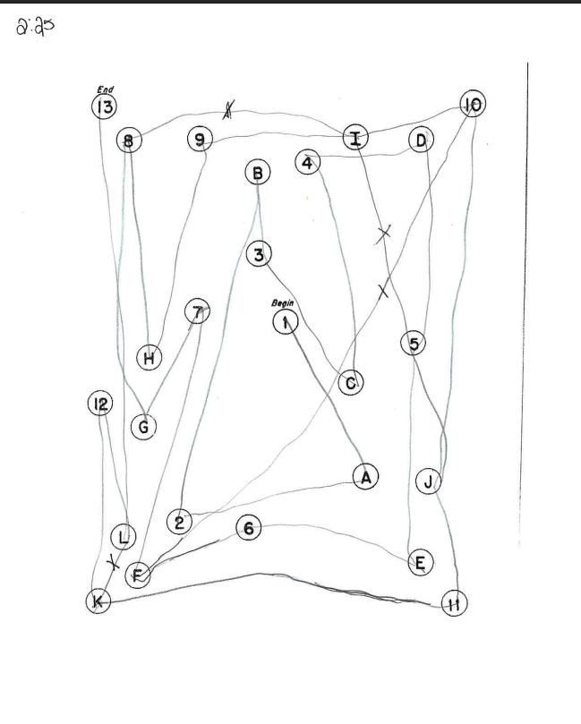
Neuropsych Testing Results
Notes:
Trails and A and B. Trails B he had 4 errors and finished in 2 minutes and 25 seconds.

Slide 20
Labs and Screening Results
RPR-nonreactive
B12-397
TSH-0.81
PHQ9 score 5
GAD7 score 1
Notes:
RPR was nonreactive, B12 397, TSH 0.81, PHQ9 score 2, GAD7 score 1

Slide 21
MRI
See MRI scans
Notes:
Study ID – Confidential33, Ordering System Phoebe Putney
Axial Flair A:3-mild vascular changes.
Sagittal A:2-diffuse volume loss
Axial T1 A:6-mild medial temporal lobe atrophy
T2 Coronal A:5- hippocampal atrophy
SWI A:4- image 6 left cerebellum, 28 left occipital, 43 right occipital. 3 microhem.

Slide 22
Possible Diagnosis
MCI
AD
Depression
OSA
Notes:
Differential list for him includes MCI, AD, depression, OSA. We recommended LP. He was pretty reluctant to agree with LP but his wife informed him that he would be moving forward with LP. As I mentioned earlier, his sister was also being seen and had had her follow up appointment a few weeks prior to his follow up appointment and she had declined LP or blood biomarkers. This was back before we were doing routine blood biomarkers and before we realized that it was getting covered by insurance. After her brother scheduled his LP, she called the following day and decided to go ahead schedule LP.

Slide 23
LP Results
LP results
  Abeta 437.25
  T-tau 429.75
  P-tau 71.75
  APOE E3/E4
Notes:
Here are his LP results: Abeta was 437, Ttau 429, Ptau 71, apoe E3/E4.

Slide 24
Diagnosis & Recommendation
MCI d/t AD
  Referral for lecanemab.
  Start donepezil 5mg.
  Regular physical activity.
  Mediterranean diet.
  Social activities.
  Brain exercises.
Notes:
He was diagnosed with MCI d/t AD. He did want to move forward with lecanemab and so we referred him to neuro.

Slide 25
Lecanemab Paused
Developed severe headache, fever, runny nose.
PCP ruled out infection.
STAT MRI obtained.
Notes:
He had his first infusion and the following day, he called complaining of severe headache, fever and runny nose. Neuro sent him to PCP to rule out any possible causes of infection. PCP cleared him so neuro ordered a stat MRI.

Slide 26
STAT MRI
See MRI scans
Notes:
Study ID – Confidential34, Ordering System Phoebe Putney
Here is the SWI on the stat mri. There are 3 new microhemorrhages in addition to the previous 3 in the left cerebellum, left occipital and right occipital.
Image 44, 56, 62. He was diagnosed with mild ARIA-H and Neurology chose to suspend infusions until symptoms resolved. His headache did resolve and follow up MRI one month later showed 4 microhemorrhages. He decided to resume dose 2 on sister's lecanemab schedule so that they can commute to infusions together.

