Slide 1
Name of Site: Macon MAC
Date: 2/17/2023

Slide 2
#1 Patient Demographics
70yo F, 12yrs Education
Reason for visit
Chief Complaint: Memory problems x 5yrs
History of Present Illness:
Posting notes, progressively worse/notes no longer helping. Forgets conversations/withdrawn/talk to dog more than husband/ unable to cope with conversations during social gatherings/does not correct number of grandchildren.
Unable to manage finances.
Able to do ADLs and dress appropriately
Not lost driving
Hypnotic dependent until about 2yrs ago.
Diagnosed B12 def Jan 2022
Positive FH of dementia

Slide 3
Medical History
Medical history
Hypothyroidism
Vitamin B12 def
Remote h/o meningitis in teenage years
Current Medications
Levothyroxine 25mcg daily
Vit B12 100mcg daily

Slide 4
Additional History
Family History
Mother: Lewy Body Dementia, died 1980s.
Social History
No tobacco, alcohol or drug use
12th grade Ed, Retired Dental Hygienist 2017. 2nd marriage. 2sons, 4 grandchildren.
Surgical History: None

Slide 5
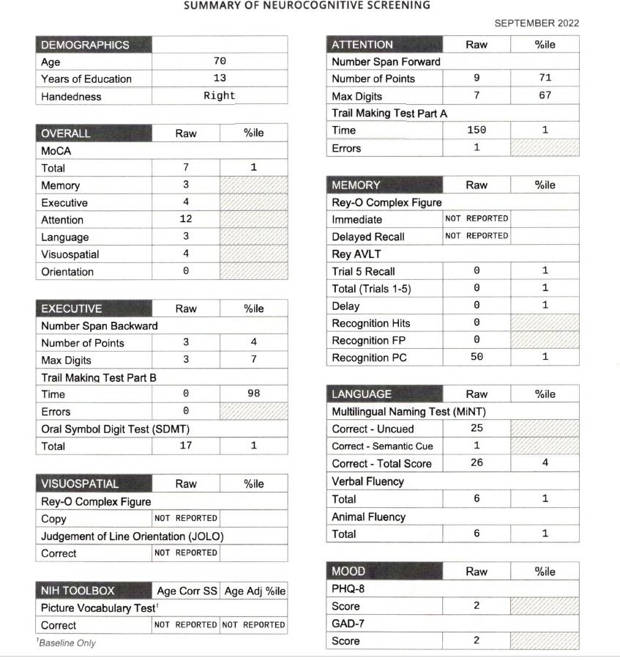
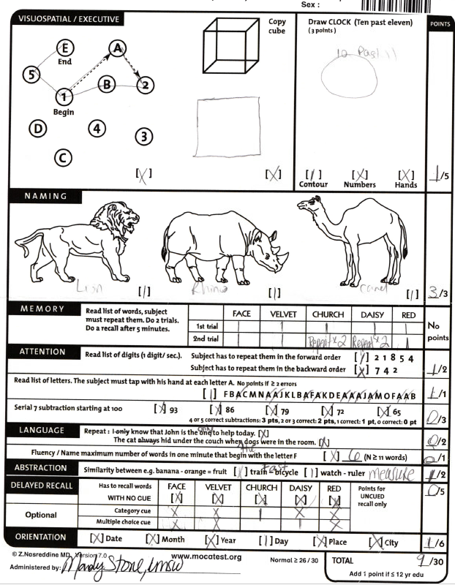
Neuropsych Testing Results

Slide 6
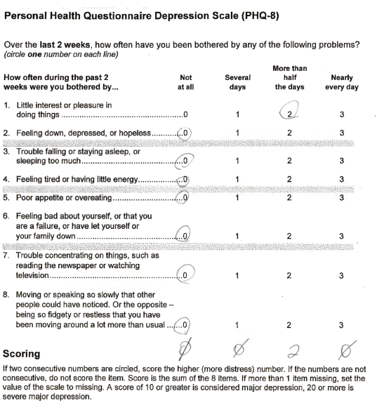
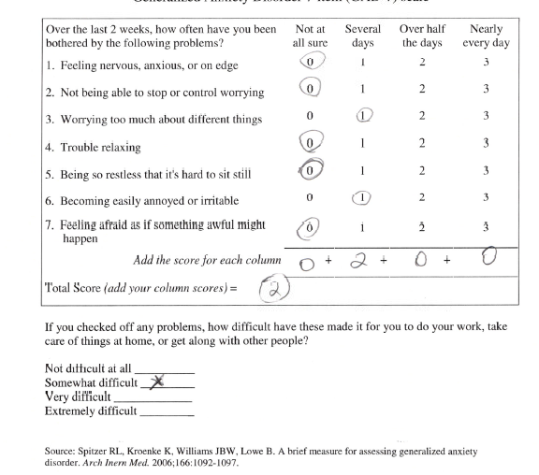
Neuropsych Testing Results

Slide 7
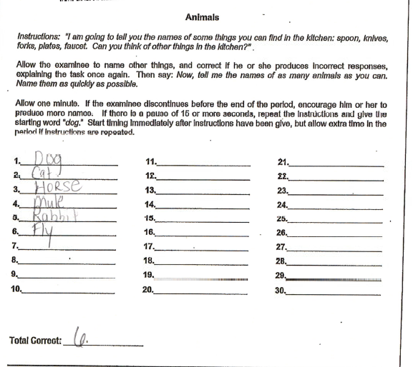
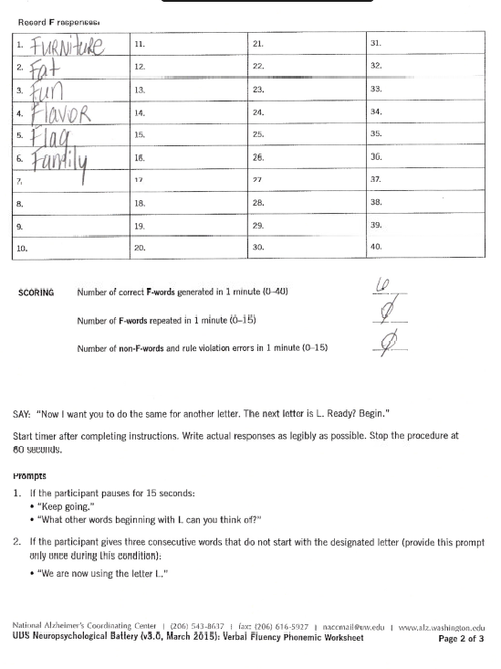
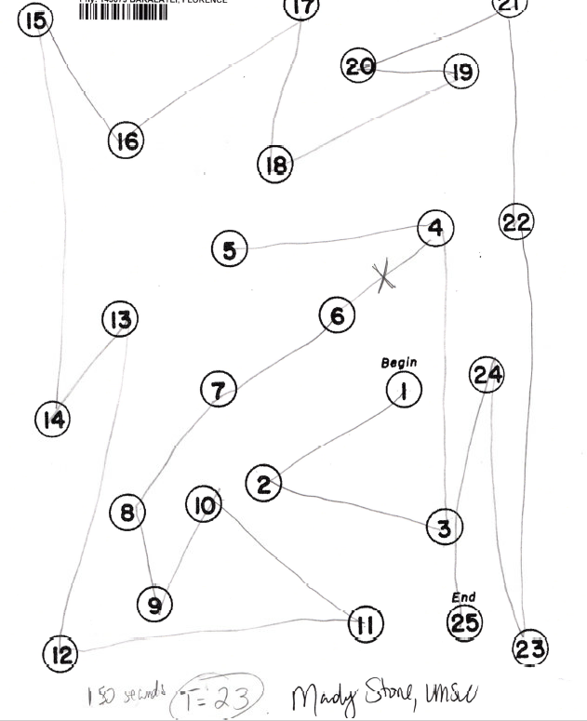
Neuropsych Testing Results

Slide 8
Labs
TSH, RPR, Chem, CBC WNL
Vit B12 208

Slide 9
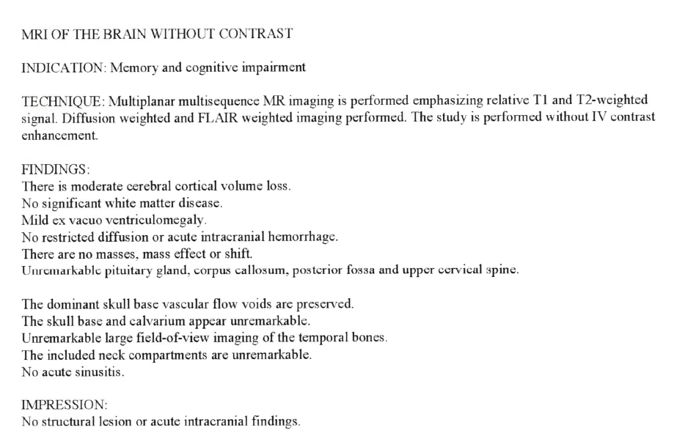
MRI report

Slide 10
MRI
See images

Slide 11
LP Results
Not done

Slide 12
Possible Diagnosis
Vitamin B12 Deficiency
Moderate Alzheimer’s Dementia

Slide 13
Recommendation
Pharmacotherapy
Exercise
Referral to AA and AAA

Slide 14
#2 Patient Demographics
69yo F 12th grade Ed
Reason for visit
Chief Complaint: Memory concerns
History of Present Illness:
Memory problems since 2012, worse in past 3-4yrs
Forgetting grocery lists, forget grandkids’ birthdays/marriage anniversary/duration of marriage
Concerns with driving
Depression and worsening memory x2yrs after parents died (father aged 94yrs 2020, mother aged 87yrs 2021

Slide 15
Medical History
Medical history
CAD
GAD
Major depression
Vertigo
OAB/Genital prolapse
Current Medications
Clonazepam 1mg every other day
Lexapro 20mg
Solifenacin (vesicare)/meclizine
Ticagrelor(Brilinta)/Lisinopril/Atorvastatin, ASA, Montelukast

Slide 16
Additional History
Family History
Atherosclerosis. Breast ca and suspected dementia in mother
Social History (including alcohol, drug, tobacco use)
Smokes 1-2 cig/day, no alcohol or drug hx
12th grade Ed, Retired 2009 from shipping company where she worked as documenting and maintaining shipping container lists and placement
Married, 2 children
Surgical History
Appendectomy/Partial hysterectomy/rotator cuff repair/PCI with stenting -recent

Slide 17
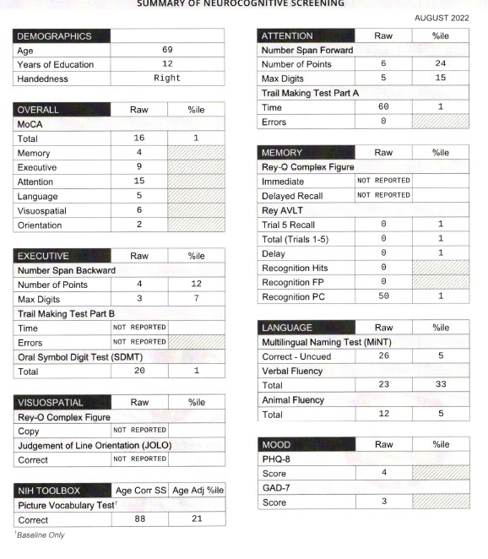
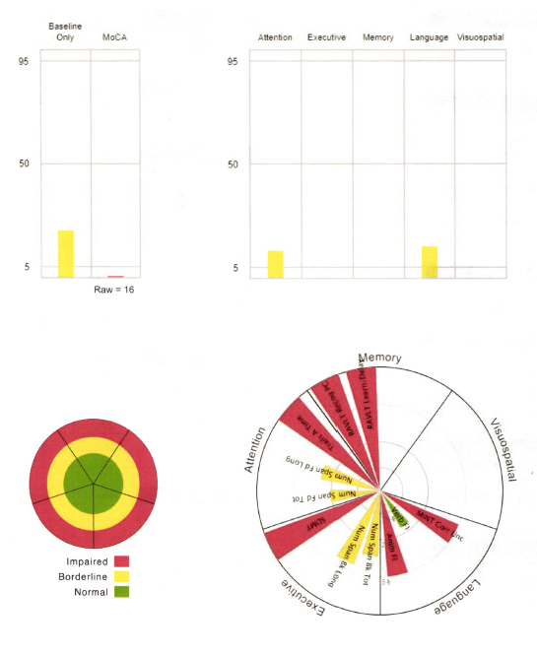
Neuropsych Testing Results
Include Testing Summary Sheet

Slide 18
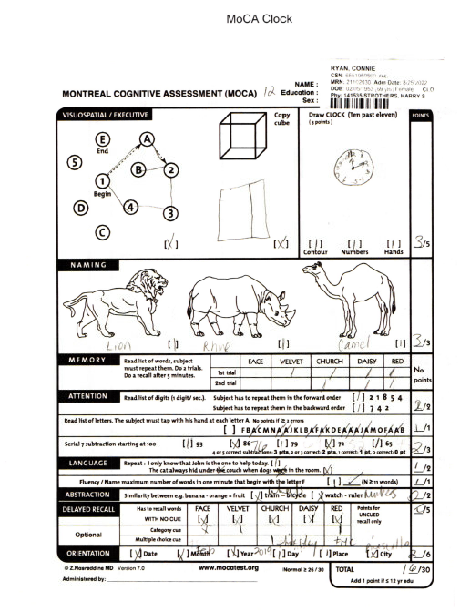
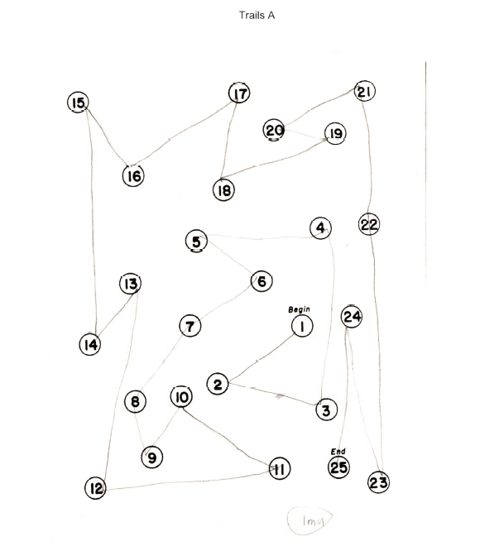
Neuropsych Testing Results

Slide 19
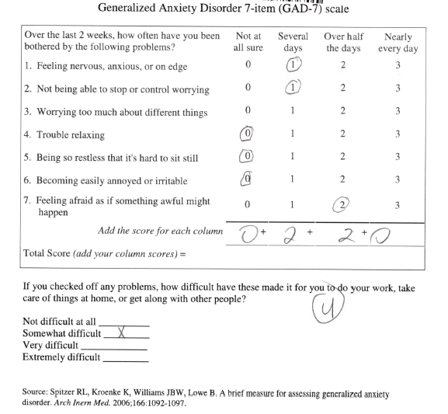
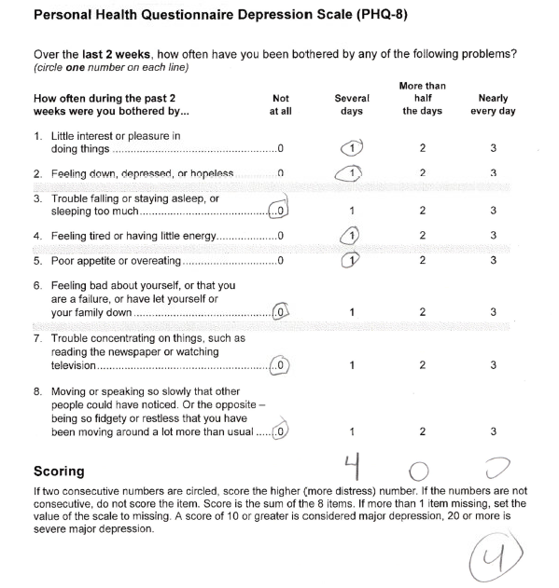
Neuropsych Testing Results

Slide 20
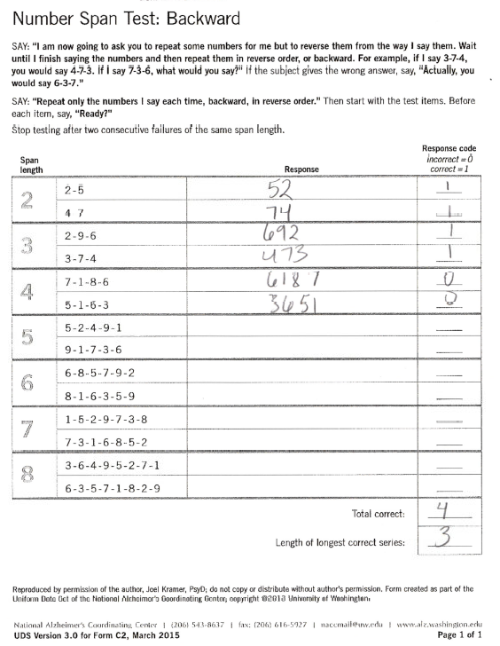
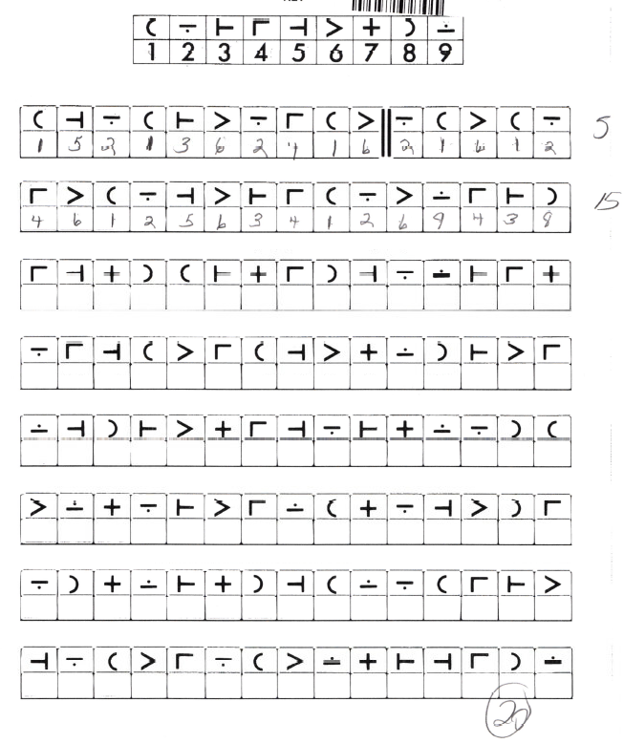
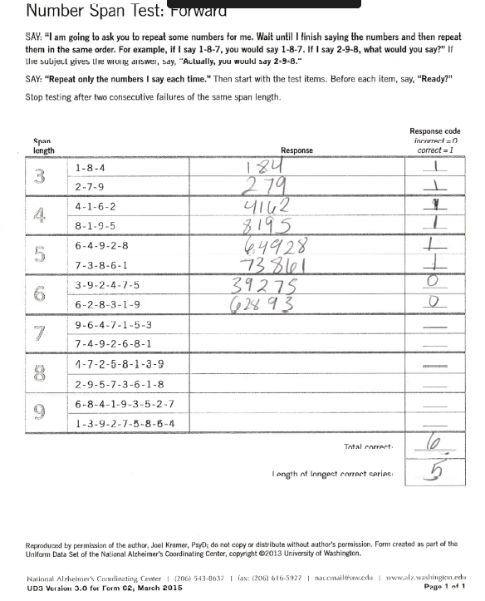
Neuropsych Testing Results

Slide 21
Labs
TSH, Chem, CBC, RPR WNL

Slide 22
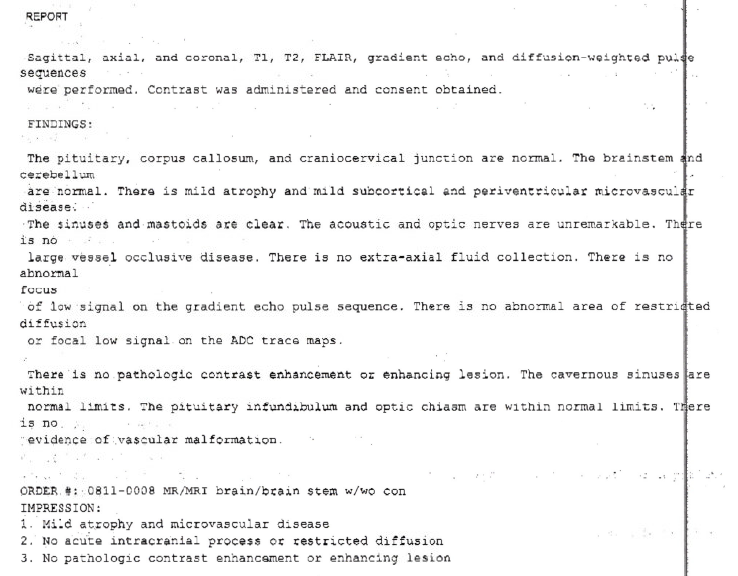
MRI report

Slide 23
MRI
See Images

Slide 24
LP Results
Not done yet due to continued need for use of antiplatelet agent

Slide 25
Possible Diagnosis
Major Depressive Disorder/GAD
Pelvic organ prolapse
Mild Alzheimer’s Dementia

Slide 26
Recommendation
Treat MDD
Surgical therapy for pelvic organ prolapse
Pharmacotherapy -Acetylcholinesterase Inhibitors
Exercises
F/U in 6mo. Consider CSF LP at that time

Slide 27
#3 Patient Demographics
75yo F 12th grade Edu.
Reason for visit
Chief Complaint: Memory problems x >1yr
History of Present Illness:
Problems balancing check book/paying bills on time/keeping up with bank statements/losing money. Dtr taken over finances. Leave same voicemail multiple times/misplace items at home. Could not recall any details of dtr’s wedding 20yrs ago. Started on donepezil 5mg a year ago, increased to 10mg.
Previously enjoyed church ladies’ group, library group. Go to theater to watch performances often, socialize. Reduced socialization due to covid-19.
Diagnosed with breast cancer 2020. Depression worse since post surgery
No FH of Dementia

Slide 28
Medical History
Medical history
CAD/HFrEF/carotid stenosis
DJD with lumbosacral neuritis
Chronic Depression/Anxiety/Insomnia
Breast cancer diagnosed Jan 2020.
Fall/small ICH 2017
Benzodiazepine dependence
Current Medications
Donepezil/Memantine
Diazepam 5mg >10yrs, 7.5mg x 1yr
Sertraline 100mg daily
Entresto/Cetirizine/Bisacodyl

Slide 29
Additional History
Family History
Mother: HTN, CVA. Father: Cancer, Heart disease
Social History
12yrs Education. Retired Cosmetologist.
Current smoker >30pac years.
No alcohol or tobacco use.
Widow. Has children and grandchildren.
Lives alone. Independent in ADLs, Drives. Relies on fast food and take out
Surgical History
Appendectomy/Bladder Suspension/Cholecystectomy/Hysterectomy/Rectocele repair/bilat mastectomy

Slide 30
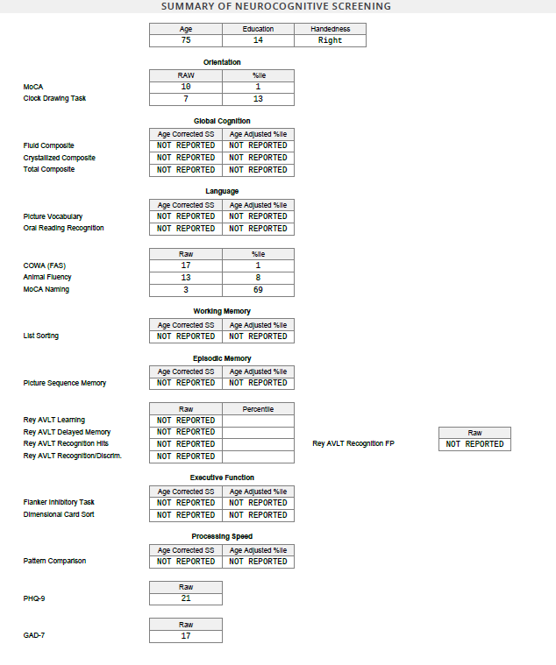
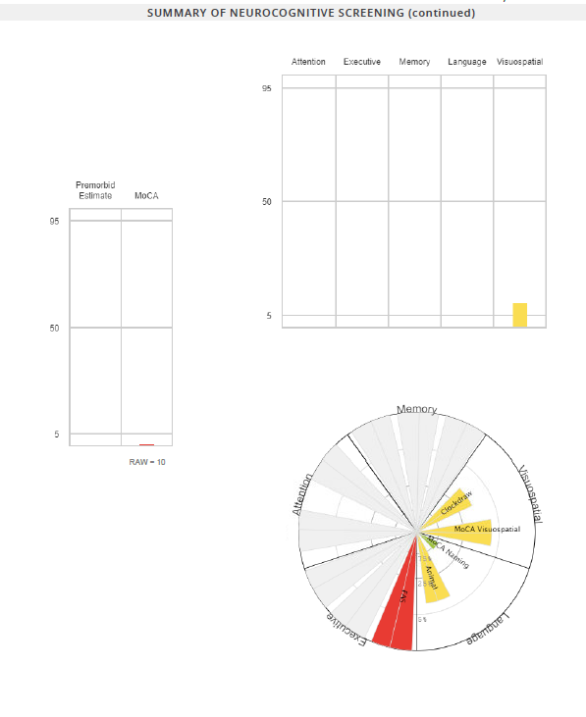
Neuropsych Testing Results 1/27/2022
Include Testing Summary Sheet

Slide 31
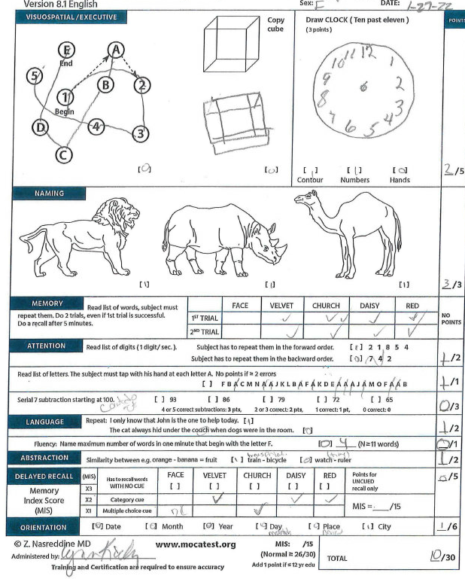
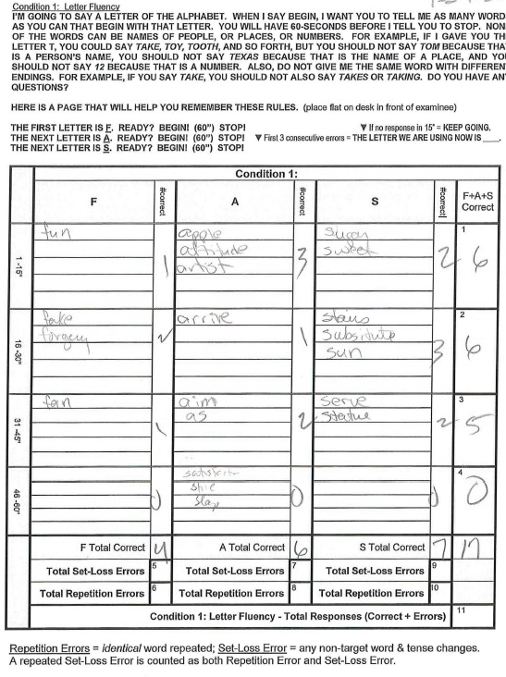
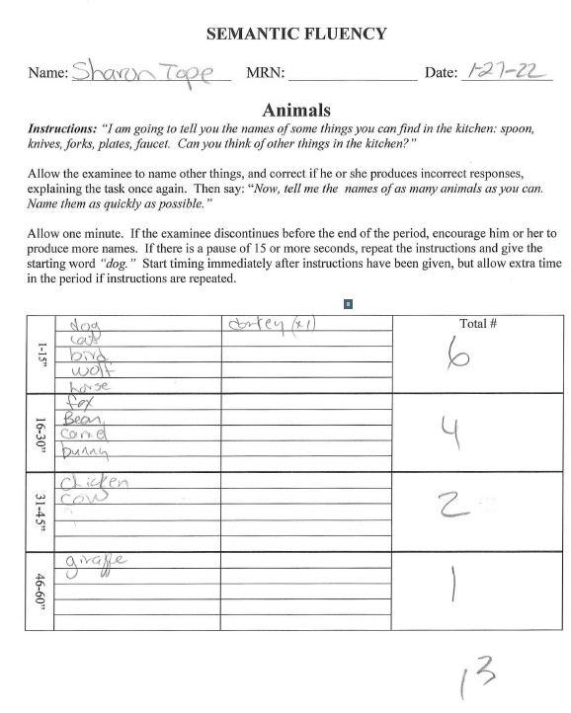
Neuropsych Testing Results 1/27/2022

Slide 32
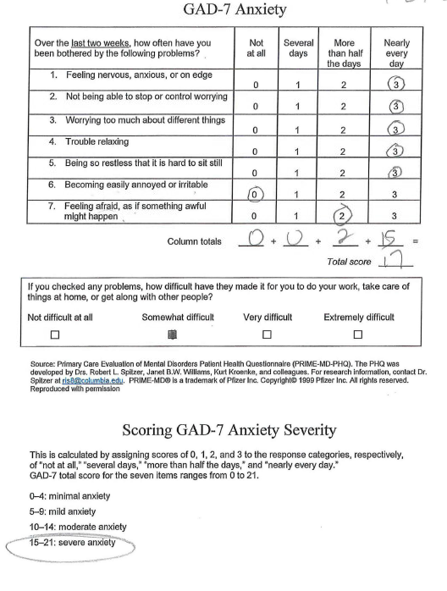
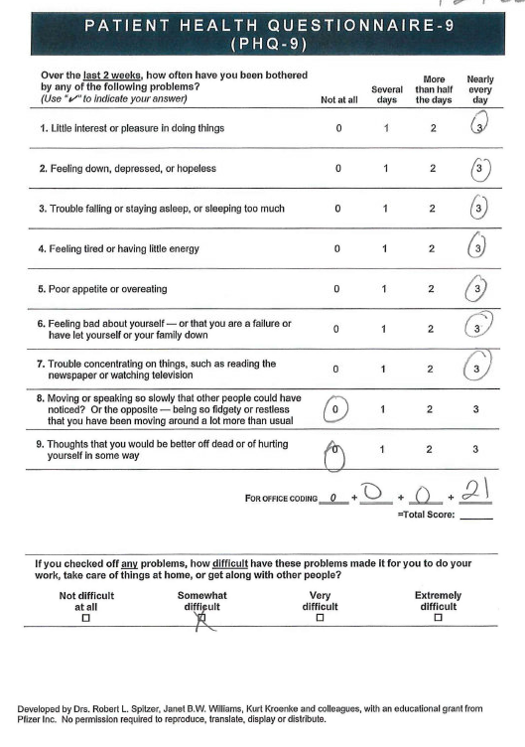
Neuropsych Testing Results 1/27/2022

Slide 33
Labs
CBC, Chem, TSH RPR Vit B12 WNL
CT brain 5/9/2021 Mild global volume loss

Slide 34
Diagnosis/Plan
Dementia, probably of Alzheimer’s type
MDD/GAD
Insomnia
Benzodiazepine dependence
PLAN
Treat mood disorder
Wean off Diazepam
RTC in 6mo for re-evaluation

Slide 35
Update Sep 2022
Antidepressant changed to Desvenlafaxine (Pristiq)
Benzo weaned off, on Trazodone for insomnia
Improved social interaction with close family
Not yet resumed church/library group
Does some crossword puzzles
Improved po intake/gained weight
Dress appropriately for weather
Concerns
Recycle same clothes
Stopped from driving because dtr was uncomfortable with it

Slide 36
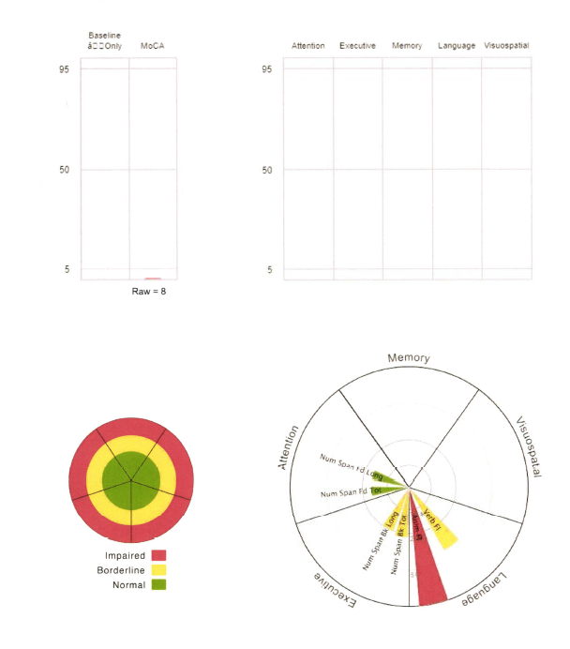
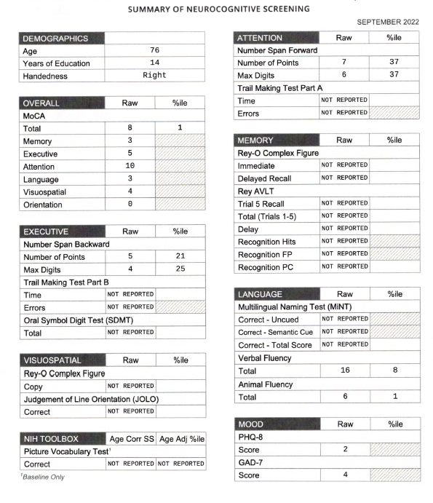
Neuropsych Testing Results 9/2022

Slide 37
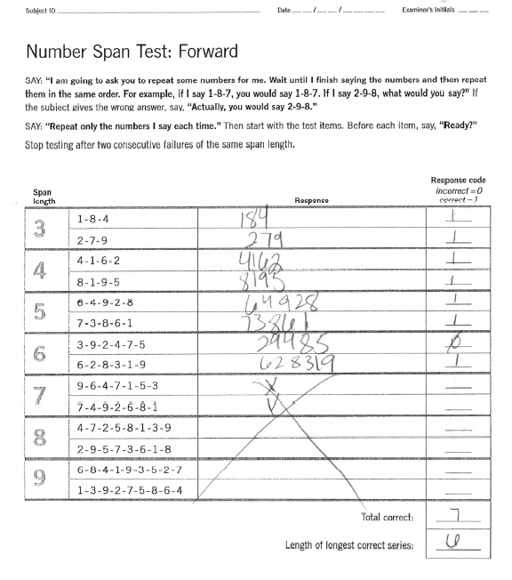
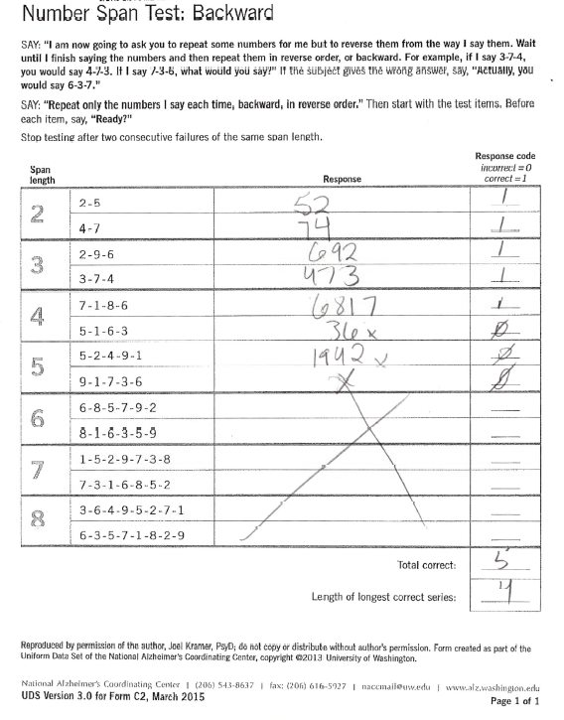
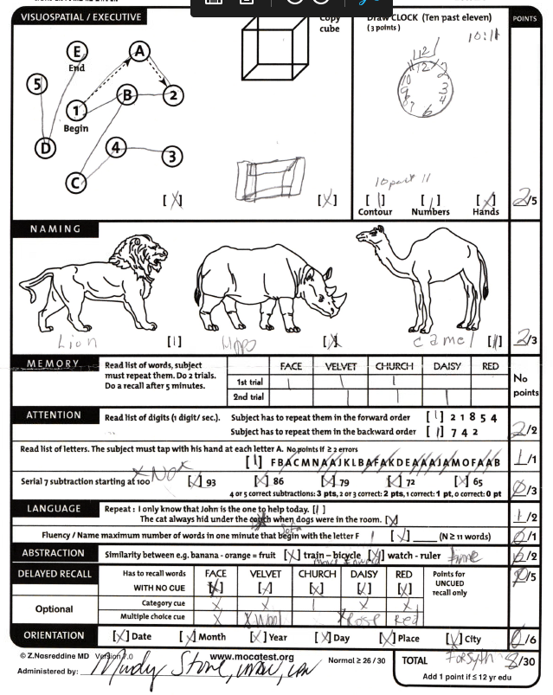
Neuropsych Testing Results 9/2022

Slide 38
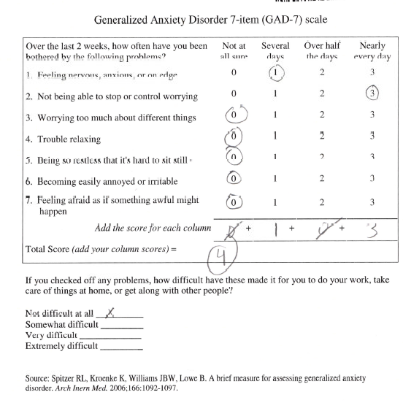
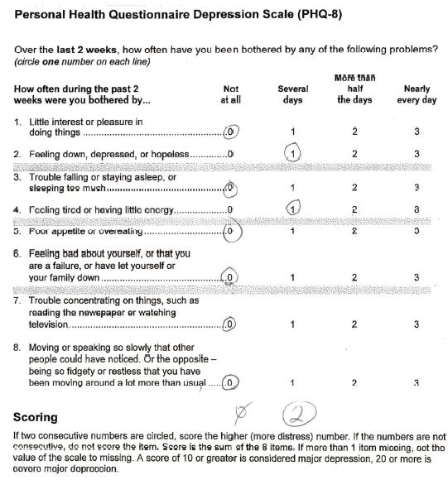
Neuropsych Testing Results 9/2022

Slide 39
MRI
See images
No report

Slide 40
LP Results
Not done

Slide 41
Possible Diagnosis
Alzheimer’s dementia
MDD –much improved
GAD –much improved
Benzo dependence –resolved.

Slide 42
Recommendation
Cont Donepezil, Memantine
Cont Trazodone
Cont increased social interaction.
Refer AA and AAA

