Slide 1
Name of Site: Albany MAC
Date: March 21, 2025

Slide 2
Patient Demographics
58 yo Caucasian female
12 years of education
Retired 1 ½ years ago-bookkeeper at family business
Onset approx 2 years ago
Difficulty processing thoughts, remembering names, repetition, and misplacing items
Personality changes-easily angered and frustrated
Intermittent fine hand tremor bilat x several years
Lives at home with husband
Rocky marriage/verbal abuse-currently in couples counseling
Independent of basic ADLs
No confusion or accidents with driving
Prepares meals-occasionally leaves the stove/oven on and burns things
Responsible for household finances-occasionally forgotten a bill
No falls or problems with balance
Trouble with sleep pattern
Has taken Ambien five years and recently taken off-memory complaints improved
Started on Trazadone and reports no relief
Now taking Ativan
Notes:
Our first case is a 58-year-old white female that was seen in January of 2022 by a previous provider. She has 12 years of education and has been retired for about 1-1/2 years from a family owned business as a bookkeeper. She notes onset of memory changes approximately 2 years prior. She was having difficulty with processing thoughts, remembering names, repeating herself, and misplacing things. She states that she is much easily angered and frustrated than before. She has intermittent fine hand tremor that she reports as having for several years. She lives with her husband. She described that they have a rocky marriage that is at times verbally abusive and that they are currently in marital counseling. She is having no difficulty with ADLs. She still drives and denies any confusion or accidents. She still cooks and occasionally leaves the stove on and gets distracted and burns food. She is responsible for the household finances and admits that she occasionally forgets to pay bills. She denies forgetting to take her medications. She has not had any falls or balance problems. She has a long history of insomnia has been taking Ambien for about 5 years and recently stopped. Her husband noticed improvement in her memory since stopping the Ambien. She has since started trazodone but reports that this is not helping so PCP has started lorazepam.

Slide 3
Medical History
Problem List
Hypertension
Renal aneurysm
Depression/anxiety
GERD
Insomnia
Hyperlipidemia
Ulcerative colitis
ADHD
Medications
Atorvastatin 10mg QD
Dextroamphetamine-amphetamine 30mg QD
Escitalopram 20mg QD
Lorazepam 0.5mg PRN
Triamterene-HCTZ 37.5-25mg QD
Notes:
Past medical history for her include hypertension, renal aneurysm, depression, anxiety, GERD, insomnia, hyperlipidemia, ulcerative colitis, and ADHD. Her current medications are atorvastatin, dextro amphetamine amphetamine, Ecitalopram, lorazepam, and triamterene/HCTZ.

Slide 4
Additional History
Uncertain of family of AD.
Denies any alcohol, drug, or tobacco use
Notes:
She was uncertain of any family history of AD. She denied any alcohol, tobacco, or drug use.

Slide 5
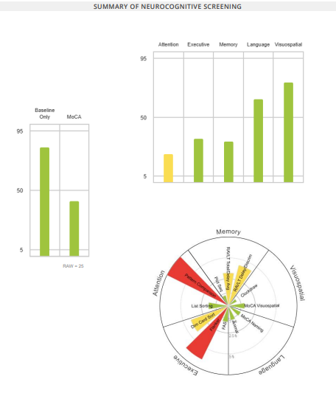
Neuropsych Testing Results
Notes:
She scored a 25 on the MoCA. FAQ was 10. She was borderline on Rey AVLT delayed and recognition. Attention domain was borderline.

Slide 6
Lab and Screening Results
RPR - nonreactive
Vitamin B12 - 1142
TSH - 4.08
PHQ-9 ~9
GAD-7 ~ 11
Notes:
Lab work was unremarkable. She scored a 9 on PHQ and 11 on GAD.

Slide 7
MRI
See MRI scans
Notes:
CONFIDENTIAL 31.
Flair-minimal vascular changes.
Sagittal-MPR: She has some focal parietal atrophy.
Axial MPR: Medial temporal lobes look pretty good.
Coronal: Parietal atrophy, hippocampi look pretty full.
SWI: Normal

Slide 8
Diagnosis and Recommendations
Mixed anxiety and depressive disorder
Recommended changing Escitalopram 20 mg to Venlafaxine 37.5 mg PO daily as tolerated and then increasing to 75 mg PO daily
Mediterranean diet
Discussed different coping mechanisms
Recommend individual counseling with behavioral psychologist
Notes:
She was diagnosed with mixed anxiety and depressive disorder. Recommendations included that PCP change escitalopram to venlafaxine 37.5 mg daily and then increase to 75 mg daily, Mediterranean diet, and individual counseling with behavioral psychologist, as well as education on coping mechanisms.

Slide 9
Patient Demographics
Returns 2 ½ years later for worsened memory
New complaints-having difficulty with word finding, keeping appointments, keeping up with events/holidays
Personality changes-more withdrawn/agitation
Still lives at home with husband.
Independent of basic ADLs
Husband now keeps up with her appointments.
Still driving-no accidents, forgets where she was driving
Prepares meals-trouble remembering recipes and ingredients
Assists with household finances
Still no falls or problems with balance
Sleeps well with an OTC sleep aid
Reports daytime drowsiness and occasional naps.
Notes:
This same female patient was referred back to us just over 2-1/2 years later for worsened memory. She is now 60 years old. She notes gradual progression since her last MAC visit. She is now having difficulty with word finding, keeping appointments, keeping up with events and holidays, and being more withdrawn and agitated. She denied any hallucinations or paranoia. She still lives with her husband and that relationship has improved. She is still not having any trouble managing her medications. She is still driving and still reports no confusion or accidents but forgets where she was going to go. She denies any regular exercise and is still not having any trouble with balance or falls. She still has trouble with remembering recipes and ingredients. She denied any appetite or weight changes. She does report that her sleep quality has improved with an OTC sleep aid of which she is unsure of the name. She admits that she is still struggling with anxiety and depression. She denied any hobbies or interests stating that she just stays home and does nothing except for when she attends an event of her grandchildren. Her affect was flat and tearful at times. Her PCP did refer her to behavioral health after last MAC visit but unsure of why it was never scheduled.

Slide 10
Medical History
Problem List
Hypertension
Renal aneurysm
Depression/anxiety
GERD
Insomnia
Hyperlipidemia
Ulcerative colitis
ADHD
IBS
Medications
Atorvastatin 10mg QD
Dextroamphetamine-amphetamine 30mg QD-DC'd
Escitalopram 20mg QD
Lorazepam 0.5mg PRN for panic attacks-DC'd
Triamterene-HCTZ 37.5-25mg QD
Aricept 5mg QD-DC'd
Phentermine 37.5mg QD
Vraylar 3.0mg QD-starting 4.5mg soon
Notes:
The only change in medical history is that she has now also been diagnosed with IBS. She has had several medication changes since her last visit. PCP has added donepezil but she stopped taking soon after due to no improvement. She also stopped taking dextroamphetamine amphetamine and lorazepam. PCP added Vraylar which is being titrated to 4.5 mg soon but she is waiting on the new strength from the mail-order pharmacy.

Slide 11
Additional History
Family hx of AD
Grandfather, who passed away in 70s by suicide
Denies any alcohol, drug, or tobacco use
Notes:
Previously she was uncertain of any family history of Alzheimer's disease. Today she reports that her grandfather had AD and that he committed suicide in his late 70s.

Slide 12
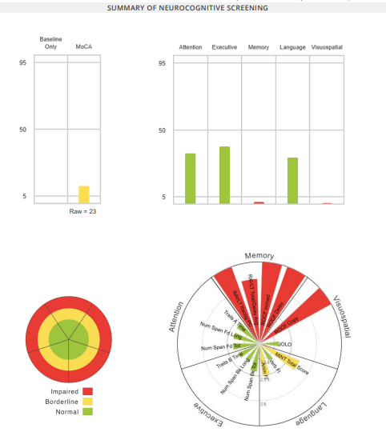
Neuropsych Testing Results
Notes:
On retest, MOCA was 25 and now is 23. She is now impaired in memory and visuospatial domains. Previously she was borderline in attention but she is now normal in attention, executive, and language function. FAQ was 3. I would like to point out that different CSEs calculated the FAQ and she was previously marked as needs assistance on some items that she was not getting assistance with so that is why there is such a discrepancy.

Slide 13
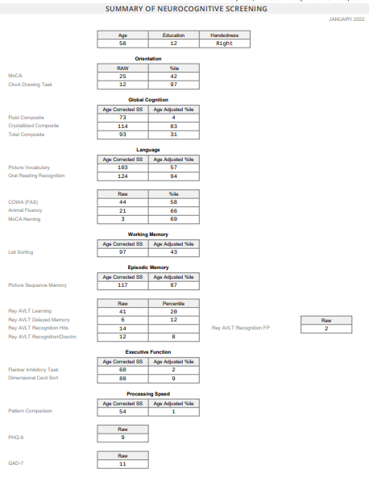
Neuropsych Testing Results
Notes:
We were somewhat limited on comparison due to the test version change. But the biggest take away is that she had a significant decline on Rey AVLT total trials, delayed recall, and recognition.

Slide 14
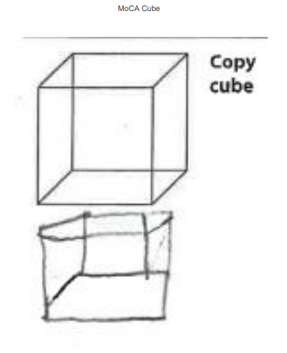
Neuropsych Testing Results
Notes:
Here is her clock and cube.

Slide 15
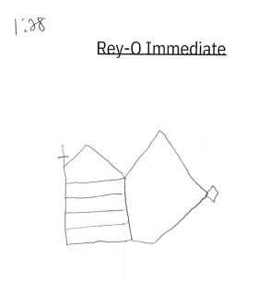
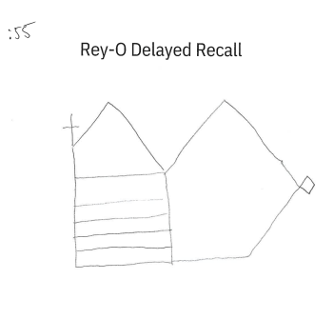
Neuropsych Testing Results
Notes:
Here is her Rey-O copy, immediate, and delayed recall drawings.

Slide 16
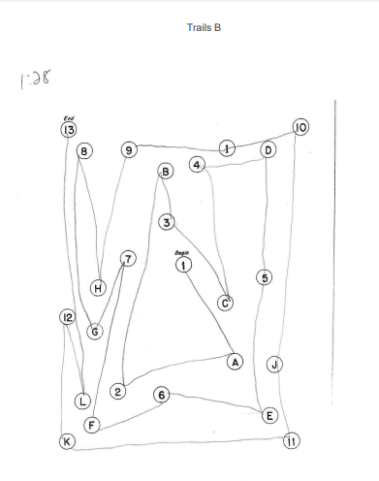
Neuropsych Testing Results
Notes:
Trails A was in the 33rd percentile and Trails B was 45th percentile.

Slide 17
Lab and Screening Results
RPR - nonreactive
Vitamin B12 - 1879
TSH - 2.75
PHQ-9 ~14
GAD-7 ~ 8
Notes:
Labs are still unremarkable. PHQ increased from 9 to 14 and GAD decreased from 11 to 8. She was agreeable to me sending another behavioral health referral so that was done while we waited on imaging and follow up appointment.

Slide 18
MRI
See MRI scans
Notes:
CONFIDENTIAL 30
Flair-Still only minimal vascular changes.
Sagittal MPR-still focal parietal atrophy with more frontal atrophy than previous images.
Axial MPR-maybe some slight atrophy in medial temporal lobes
Coronal: slight atrophy in hippocampi
SWI: looks good

Slide 19
LP Results
LP results
Abeta ~ 549.05
T-tau ~ 633.55
P-tau ~ 112.55
ATI ratio – 0.56
RBC ~ 6
WBC ~ 2
Protein ~ 44
Glucose ~ 68
APOE ~ E4/E4
Notes:
Based on her changes from previous visit, we recommended lumbar puncture and here are those results. Her Abeta was decreased at 549. T-tau was 633. P-tau was 112. APOE was E4 homozygous. Also, when she presented for LP results, she was no longer flat and tearful but pleasant and smiling. She had stopped citalopram, Vraylar, and phentermine. Behavioral Health had reached out to her multiple times to schedule but were unable to reach her.

Slide 20
Recommendation
Alzheimer’s Disease- Early Onset, Mild Stage
Retrial of donepezil
Will notify for any upcoming clinical trials.
Brain exercises such as puzzles, word search, etc.
Regular physical activity.
Mediterranean diet-will send referral for dietitian, she would like guidance due to past GI problems/surgeries.
Social activities, limit screen time.
Daily structured routine.
Discussed resending behavioral health referral since they were unable to reach her, she prefers faith-based counseling
Genetics counseling referral.
Notes:
She was diagnosed with EOAD, mild stage. We talked at length about the increased risk of bleeding associated with her E4 status. We also talked at length that lifestyle modifications were very important. We discussed another trial of donepezil since she was not sure how long she actually took it before stopping. We will notify her of any upcoming clinical trials that she may be a candidate for. She elected to wait on lecanemab referral and incorporate lifestyle modifications. She was obviously distraught by the diagnosis and we again discussed a behavioral health referral. She preferred faith-based counseling so we did refer her to our local biblical counseling center. We also sent a genetics counseling referral to Emory. Due to her diagnosis of IBS and ulcerative colitis, she had many questions about the Mediterranean diet so we did send her for a dietitian referral. I spoke with her husband a couple of weeks ago and they had just gotten back from a trip to Israel. He said that she was doing great and even her mood had continued to improved. She now has a regular daily routine that includes exercise and her new diet recommendations and he was impressed at how much of a difference that he had seen in only 2 months. I did speak with our neurology group and they are willing to take her with increased monitoring of course. Her husband said that they would consider it and let us know if they choose to pursue lecanemab.

Slide 21
Patient Demographics
72 yo Caucasian female
12 years of education
Retired post office worker
C/o word finding, onset 1 year ago, no progression
Also reports difficulty with repetition, forgetting conversations, comprehension, keeping appointments, and misplacing items
Denies hallucinations, paranoia, or personality changes
Lives at home with husband
Independent of basic ADLs
Manages medication
Reports forgetting does and accidently double taking doses
Still drives and reports no accidents or getting lost
Created limitations due to anxiety and fear of other drivers
Prepares meals
Occasionally leaves the stove/oven on
No falls or need for ambulatory assistance
No trouble sleeping
Uses CPAP as directed
Has vivid dreams but does not act them out
Notes:
Our second case is a 72-year-old white female who presented for her initial visit back in September 2024. She asked to be referred to our services because she had really noticed that she was having a lot of difficulty with word finding which started about 1 year prior without progression. PCP notes that her last mini cog which was done 1 year prior she scored 5 out of 5 on. She was accompanied by her husband who noted that he did not think anything was wrong with her or that she needed to be here. She also complains of difficulty with repeating herself, forgetting conversations, occasionally with comprehension, keeping appointments, and misplacing things. She denied any hallucinations, paranoia, or personality changes. She denied depression or agitation but did complain of increased anxiety. She is a retired post office worker and lives with her husband. She has 12 years of education. She performs ADLs independently. She admits that she occasionally forgets taking her medications or taking double doses. She still drives but denies any confusion or accidents but states she is more scared of other drivers. She still cooks meals and occasionally leaves the stove on. She reports that her balance is good and denied any falls. She also denied appetite or weight changes. She reported good sleep quality with use of amitriptyline for many years which she also uses for migraine prevention.

Slide 22
Medical History
Problem List
Mixed hyperlipidemia
OSA
Hypertension
GERD
Vasovagal syncope
Bilateral atherosclerosis
Osteoporosis
Migraine
Sciatica
Medications
Alendronate 35mg QW
Amitriptyline 50mg QHS
Diltiazem 120mg QD
Lisinopril-HCTZ 20-12.5mg
Meloxicam 15mg QD
Ondansetron 4mg PRN
Pregabalin 75mg QD
Rosuvastatin 40mg QD
Sumatriptan 6mg/0.5mL PRN
Aspirin 81mg QD
Notes:
She has a history of hyperlipidemia, hypertension, OSA with regular use of CPAP, GERD, osteoporosis, migraines, sciatica, and insomnia. Her daily medications include amitriptyline, diltiazem, lisinopril HCTZ, meloxicam, pregabalin, rosuvastatin, and aspirin. She takes Zofran and sumatriptan as needed for migraines. And she is also taking alendronate weekly.

Slide 23
Additional History
Alzheimer’s
Mom passed in her late 80s
Aunt passed from EOAD in her late 60s to early 70s
Former tobacco use of 35-40 years, quit 25 years ago.
Previous heavy alcohol use, now rare use.
No drug use.
Notes:
She did report a family history of AD. Her mom passed away in her late 80s with AD and she also had an aunt that passed away in her 60s with EOAD. She is a former smoker of 30 to 45 years, she quit 25 years ago. She did admit to previous heavy alcohol use but now rare use of alcohol.

Slide 24
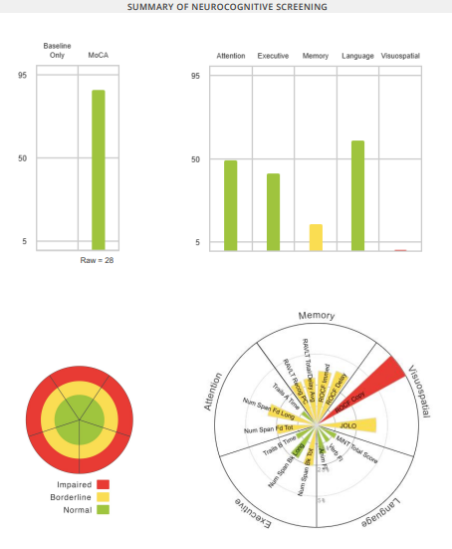
Neuropsych Testing Results
Notes:
She scored a 28 on her MoCA. FAQ was 0. She was impaired in visuospatial domain and borderline in memory domain.

Slide 25
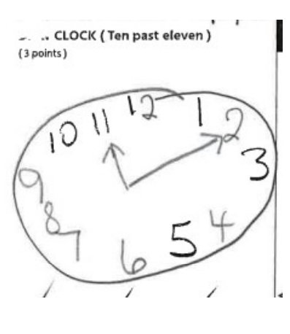
Neuropsych Testing Results
Notes:
Here is her cube and clock.

Slide 26
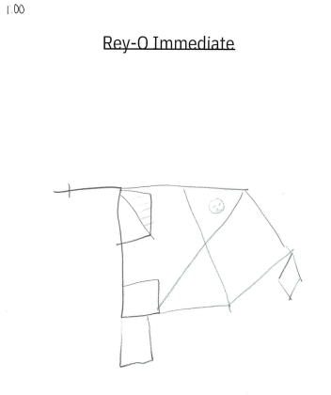
Neuropsych Testing Results
Notes:
Here are her Reyo Drawings.

Slide 27
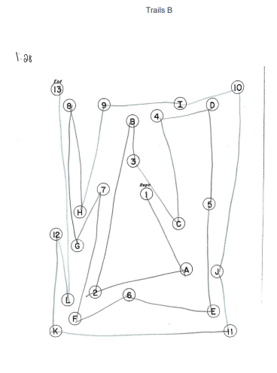
Neuropsych Testing Results
Notes:
Here is her Trails A and B. She scored in the 61st percentile on Trails B.

Slide 28
Lab and Screening Results
RPR - nonreactive
Vitamin B12 – 293*
TSH - 1.030*
PHQ-9 ~0
GAD-7 ~ 4
*Labs done by PCP within the last year
Notes:
Her labs were unremarkable. She scored 0 on PHQ-9 and 4 on GAD7.

Slide 29
MRI
See MRI scans
Notes:
CONFIDENTIAL 32
Axial Flair-mild vascular changes.
Sagittal-general volume loss. Slightly decreased occupancy on the left hippocampus. Diffuse volume loss.
Axial MPR-mild medial temporal lobe atrophy
Coronal-pretty mild atrophy, slightly more on the left
SWI-looks good

Slide 30
LP Results
LP results
Abeta ~ 561.05
T-tau ~ 506.85
P-tau ~ 107.4
RBC ~ 0
WBC ~ 1
Protein ~ 41
Glucose ~ 59
APOE ~ E3/E3
Notes:
Due to her personal concern, family history, and neurocog results, she elected to move forward with further investigation and LP was ordered. Those results were Abeta 561, T-Tau 506, P-Tau 1.0, ATI ratio 0.67. APOE E3/E3.

Slide 31
Diagnosis and Recommendations
Alzheimer's disease, Early stage.
lecanemab consult.
Start donepezil.
Brain exercises such as puzzles, word search, etc.
Regular physical activity.
Mediterranean diet.
Social activities, limit screen time.
Daily structured routine.
Notes:
She was diagnosed with AD early stage. She wanted to more forward with lecanemab consult. We also started donepezil, she called us said that it was causing insomnia-we recommended taking in the morning and this didn't help so she discontinued it. This patient was not our first lecanemab referral but was our first MAC patient to start infusions. She was diagnosed on December 12th, had her neuro consult on December 30th, and had her first infusion on January 27th. After her first infusion, she developed severe headache with nausea and vomiting. She notified PCP and neuro and her PCP had her come in the following day. They gave her a COVID test which was negative and gave her IV fluids, steroid, and antiemetic while she was there. Neuro brought her in for stat MRI which was clear. A few days later she was still complaining of severe headache and her husband took her to the ER where she received more fluids, steroid, and antiemetic. Headache, nausea and vomiting slowly improved. She decided to continue with infusions and they are now premedicating her with steroid, Tylenol, and Benadryl. When I talked with her at the beginning of March, she had had 3 infusions, and was still complaining of dull headache but that it was tolerable. She does have a history of migraines but noted that this headache was different and located in frontal region and her migraines usually start in the neck and base her head.

