Slide 1
Name of Site: Macon
Date:2/16/24

Slide 2
Patient Demographics
80yo male, 19yrs of Education
Reason for visit: Memory problems. Want to know if he has Alzheimer’s dementia
History of Present Illness:
Pt:
“My memory is just mixed up! …”
Does not know where he worked.
Told wife he should not drive because he got confused.
Told wife he should no longer be the treasurer of his organization.
“Everything is so jumbled up/mixed up in my head”

Slide 3
HPI contd
Wife:
Started when he was started on Trulicity -1/5/22.
Less interest in socializing/loss of interest in doing things/isolated
Slower/Fatigue/weakness
Stopped reading books/interest in politics
Rapid decline in function
Delusion/searching for things
Saw PCP, started on Alprazolam and Fluoxetine 3/1/22
Rapid decline in memory/significant weight loss.
Admitted to Hospice care for Failure to thrive and progression f Alzh dementia.
Started on Depakote (possible seizure)/changes made to diet to improve intake.
No FH of dementia.
Did genetic testing via 23 and me, not known to be APOEe4 carrier.

Slide 4
HPI contd –order of events through 2022
Seen at Mayo Clinic 11/1/22
ED 5/19/22, picked up by police after wandering from home (recurrent), found to have dehydration/hyponatremia. New A fib and started on Eliquis. Na 122. records indicate evaluation and treatment for progressive cognitive decline since early 2022.
EEG 6/1/22: Abnormal due to mild background slowing.
Symptoms since 1/5/22. Feb, inexplicably worried about is estate planning and bill payment. A week later, told his wife to begin paying bills.
Became worried about his ability to function as a treasurer for a local organization. Would wake up a night worried and have difficulty falling back asleep. Fluoxetine/alprazolam had a paradoxical response –unusual dreams.

Slide 5
HPI contd –order of events through 2022
Saw PCP 3/16/22 and hospitalized for 3 days.
Seen by Psych and discharged on Quetiapine.
Readmitted days later for Hyponatremia/could not comprehend fluid restriction.
Stopped driving end of March.
April –stopped reading/writing declined. Neuropsychological assessment complicated with test anxiety.
April/May: Tried on various meds by Psych with no clear response to tx. Wandering/leaving home without clothing/required in-home caregivers.

Slide 6
HPI contd –order of events through 2022
July: difficulty staying in the car on trips out. Saw Neuro and diagnosed with suspected RPD due to AD. Encouraged to seek a 2nd opinion. Referred to Mayo.
Admitted to hospice due to precipitous decline and escalations in behavior.
August: brief spells of altered consciousness. VPA for possible seizures. Improved behavior.

Slide 7
HPI contd -Deficits
Difficulty managing medications. Assistance with appointments. Difficulty with recalling recent conversations but may recall dates from the past.
Not always know day of week or month. Stopped wandering. Knows way around home/?local neighborhood
Judgement/problem solving poor. Not contribution to decision making –cannot order for himself if dinning out. Not always socially appropriate. Prefers to sleep
Function in community: poor. Reluctant to leave the house. No longer driving due to memory and thinking.
Function at home: moderately impaired. Limited to sleep and resting. Unable to do dishes. Can sort laundry with supervision. Unable to use appliances –phone/computer. Can talk on phone if placed on speaker mode. Wife picks out clothes. Needs prompting to shower/needs reminder to use soap. Wife adjusts water temperature.
Delusions –financial loss
Hallucinations –auditory
Aggression –absent but occasionally uncharacteristically angry and short-tempered.
Disinhibition/irritability or lability
Sleep –dream-wake confusion/vivid dreams/confusion on waking. No snoring or acting out dreams. Weight loss present but appetite improved since VPA (191 → 120 → 140)
Pt reports mood is “crappy and hopeless”. “feeling as if he is "in an endless loop where everything is disoriented--I'm disoriented; I don't know how time is kept here; it just seems that it's backwards and forward; the water is contaminated". The CS reports that mood is depressed / sad. “

Slide 8
Medical History
Medical history
DM II, CAD, A Fib s/p Ablation, HTN, HLD, Aortic stenosis. Anxiety with Panic attacks/depression. Major Neurocognitive Disorder Senile with Delusion
Current Medications
Depakote 250mg in AM, 500mg HS
Lexapro 10mg daily
Lorazepam 0.5mg bid prn
Methylphenidate 5mg bid
Prednisone and Tessalon Perles (since d/o covid 19 infection)

Slide 9
Additional History
Family History
Father had Parkinson’s disease.
Social History
Married to current wife 31yrs. 2 sons from previous marriage, 1 from current marriage (adopted).
Retired Real Estate/Corporate Attorney 2009.
Smoked pipe x 25ryrs.
Surgical History
Cardiac Ablation

Slide 10
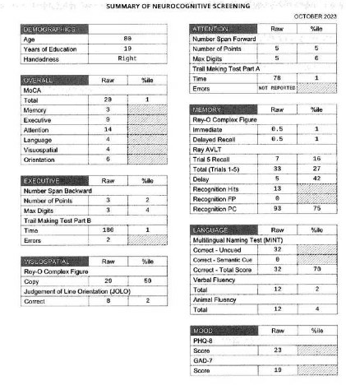
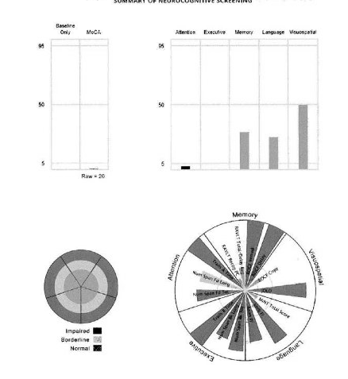
Neuropsych Testing Results
Include Testing Summary Sheet

Slide 11
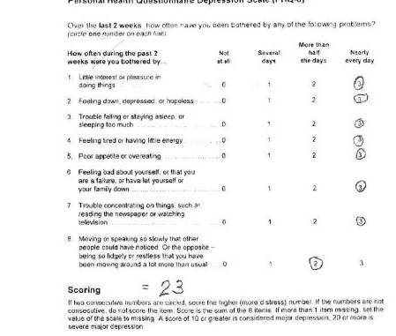
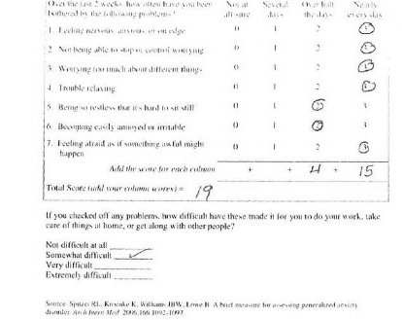

Slide 12
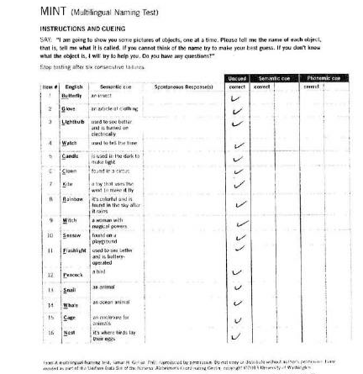
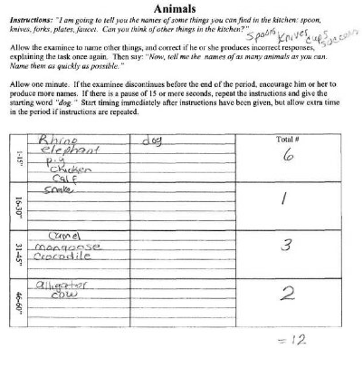

Slide 13
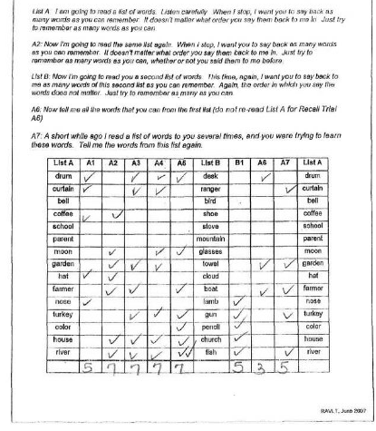

Slide 14
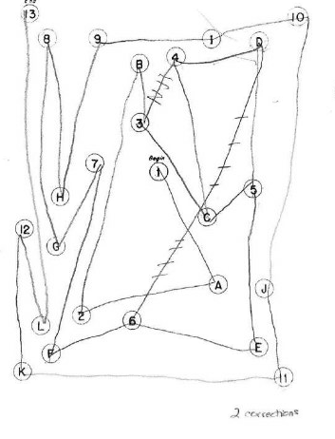
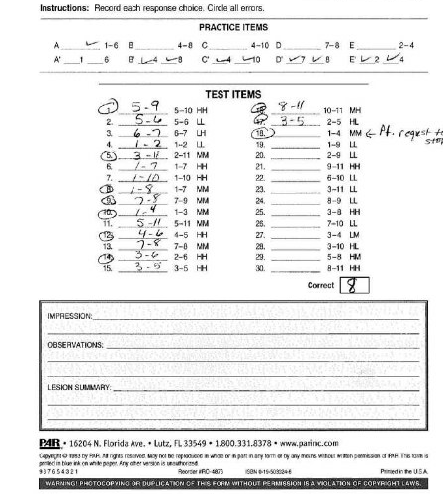

Slide 15
Labs
CBC H/H 10.7/33.5
TSH, Sensitive 0.3 - 4.2 mIU/L 4.3 High
T4 (Thyroxine), Free, S 0.9 - 1.7 ng/dL 1.0
Vitamin B12 w/ Reflex 180 - 914 ng/L 1,183 High
Thyroperoxidase Ab, S <34.0 IU/mL <15.0
HIV-1/-2 Ag and Ab screen Negative
RPR Screen w/ Reflex to Titer,S Negative Negative
CSF Olig Bands Interpretation <2 bands 0
Rapid drug screen: Negative
Alcohol: Negative

Slide 16
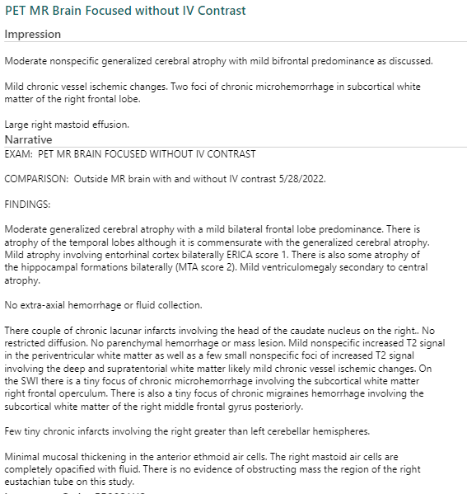

Slide 17
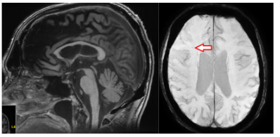
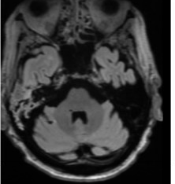
MRI Images

Slide 18
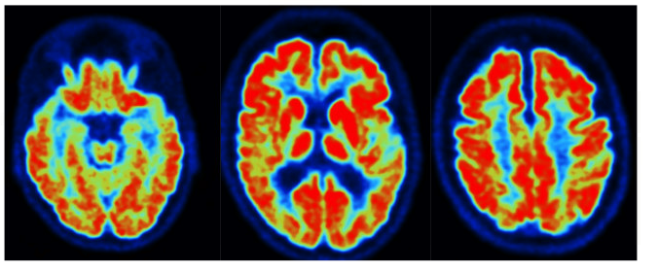
FDG PET Images

Slide 20
Neuro personal report of images

Slide 21
Labs –Gen CSF results
IgG, CSF <=8.1 mg/dL 3.0
Albumin, CSF <=27.0 mg/dL 28.9 High Protein, Total, CSF 15 - 45 mg/dL 46 High
IgG/Albumin, CSF <=0.21 0.10 Glucose, CSF mg/dL 63
CSF Color Colorless
CSF Gross Appearance Clear
CSF Supernatant Color Negative Negative for Xanthochromia
Nucleated Cells 0 - 5 /mcL <1
Erythrocytes <1 /mcL 0
Cells Counted, CSF mL See Comment
Comment: 3 nucleated cells counted for differential. For accuracy, differential counts generally have a minimum of 100 nucleated cells counted. Counts of < 100 cells indicate that there were minimal cells present in the specimen. Clinical interpretation should consider the number of cells counted as well as the total cell count (#WBC/TNC)and the percentage of each cell type present.
Neutrophils Not Seen % 0
Lymphocytes 100% mononuclear cells (lymphocytes and/or monocytes) % 100 High
Monocytes 100% mononuclear cells (lymphocytes and/or monocytes) % 0
Eosinophils Not Seen % 0
Basophils Not Seen % 0
Other Cells Not Seen % 0
Absolute Neutrophil Count, CSF 0.0 - 5.0 /mcL 0.0
VDRL Negative
Prion Panel: Likelihood of prion disease <1%
Encephalopathy/Autoimmune/Paraneoplastic panel: Negative
Neurofilament Light Chain, P <=37.9 pg/mL 39.4 High

Slide 22
CSF Alzheimer’s Disease Biomakers
p-Tau/Abeta42 <=0.023 ratio 0.027 High
AD Interpretation SEE COMMENT
Comment: The elevated p-Tau/Abeta42 ratio is consistent with the presence of pathological changes associated with Alzheimer's disease.
Abeta42 >1026 pg/mL 925 Low
Total-Tau <=238 pg/mL 267 High
Phospho-Tau(181P) <=21.7 pg/mL 25.2 High
CJD Biomarkers (CSF):
- RT-QuIC: negative
- T-tau: 730 pg/mL (elevated)
- 14-3-3: 4651 AU/mL (negative)
Amprion SYNTap Test:
- Not detected (reported 11/16/22)
Genetic testing with Invitae Hereditary Amyotrophic Lateral Sclerosis, Frontotemporal Dementia and Alzheimer Disease Panel with c9orf72 analysis has been resulted and is completely negative.

Slide 23
Diagnosis at Mayo 11/2/22
This patient is a 79 y.o. male without a family history of dementia, who presents with a <1 year history of rapidly progressive cognitive decline associated with prominent anxiety/depression, sensitivity to medications, and delusions/auditory hallucinations. Neuroimaging shows frontal-predominant atrophy. FDG PET scan shows occipital hypometabolism with possible cingulate island sign, and additional temporal hypometabolism.
The rate of decline warrants a diagnosis of rapidly progressive dementia according to research definitions of RPD (rapidly progressive dementia resulting in a change in 2 (or more) global CDR levels within 2 years); and/or permissive clinical criteria (dementia developing within 2 years of symptom onset, or progressing faster than expected for a known dementia syndrome), operationalized by Poser et al. 1999--Brain.
The most likely etiologic cause is neurodegenerative, favoring dysexecutive variant of Alzheimer disease, versus FTLD. Limbic predominant Lewy body disease remains another possibility. An autoimmune/inflammatory cause of symptoms is less likely, but does warrant evaluation to exclude given implications for treatment. A primary psychiatric cause is unlikely given the patient's late-age of onset and abnormalities on structural and functional neuroimaging, as well as EEG. Active depression, anxiety, and psychosis represent an important contribution to disability, and may be a approved further through judicious titration of appropriate medications in consultation with Psychiatry.

Slide 24
Diagnosis at Mayo (12/20/22)
1. Major Neurocognitive Disorder Senile And Delusion (HCC)
2. Major Neurocognitive Disorder Senile (HCC)
3. Mood Disorder Due To General Medical Condition

Slide 25
Possible Diagnosis
Alzheimer’s Dementia –late onset
Depression
Anxiety with Panic Attacks.

Slide 26
Recommendation
Stay active, safely
Continue f/u with Psychiatry to optimize treatment of mood d/o.
Refer AA and AAA

Slide 27
Patient Demographics –Case 2
57yo Female, 18yrs of Education
Reason for visit: Memory problems
History of Present Illness:
Pt: memory problems x 2yrs. Would go to a store and forget what she went there
Sister:
Confused on a family trip 4yrs ago
Repeating questions x2-3yrs.
Little more confused/losing things
Detached and easily aggravated
Forgot to file taxes 2023. Seems to be keeping up with bills
Supervisor called to express concern 6-8wks earlier
Evaluated by neuro and started on Donepezil 2yrs ago.
No details about how pt functions at home
Not lost driving/going to work/independent in ADLs
FH of Alzheimer’s dementia in father diagnosed at age 70.

Slide 28
Medical History
Medical history
Scoliosis with surgery at age 13-14yrs
HTN
OSA on CPAP
Seasonal allergies
Current Medications
Donepezil
HCTZ
Flonase NS/loratadine/montelukast/ hydroxyzine

Slide 29
Additional History
Family History
Father with Alzheimer’s disease at age 70, died at 75 from aortic aneurysm.
Mother living -HTN
Social History
Single, lives alone. Engineer by trade, working at the RAFB. No children. No tobacco use, drinks alcohol (wine) socially. No use of drugs.
Surgical History
Scoliosis surgery at age 13-14

Slide 30
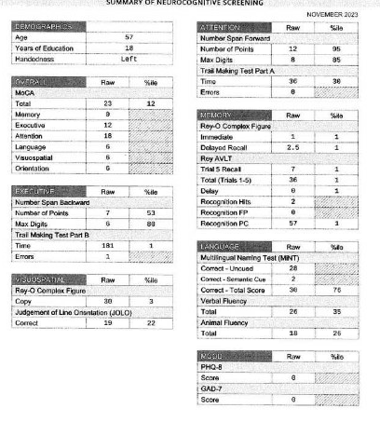
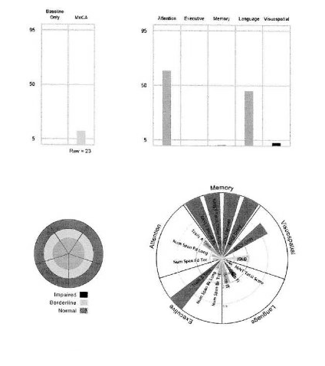
Neuropsych Testing Results

Slide 31
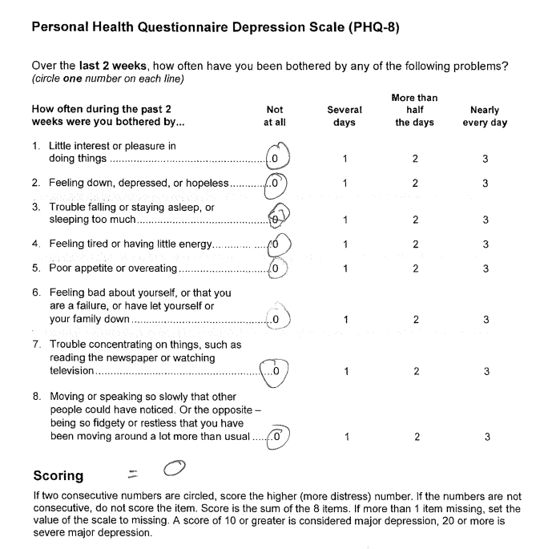
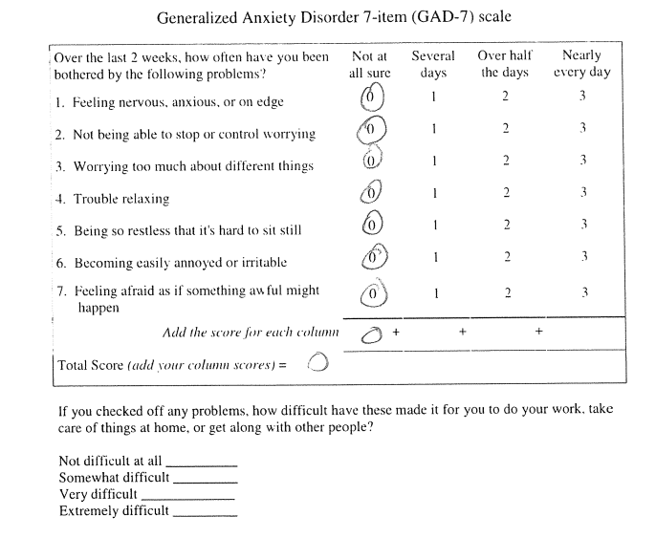
Neuropsych Testing Results

Slide 32
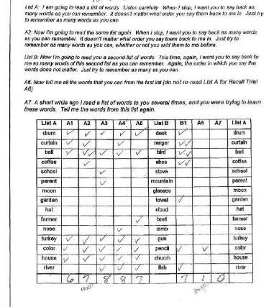
Neuropsych Testing Results

Slide 33
Neuropsych Testing Results

Slide 34
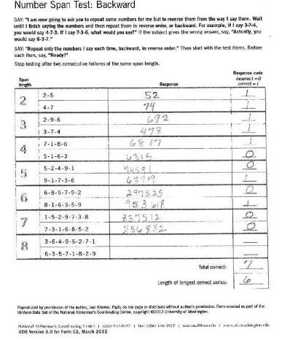
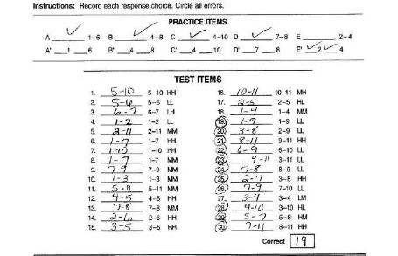

Slide 35
Labs
TSH: 0.922
RPR/Trep Pallidum Antibody: Negative
Heavy Metal Profile II: Negative
Lead
Arsenic
Mercury
Cadmium
HIV: Non-Reactive

Slide 36
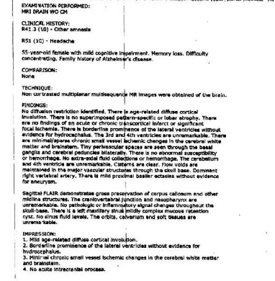
MRI Report

Slide 37
LP Results
Appearance, Fluid Clear
Color, Fluid Colorless
Supernatant Color, CSF Colorless Colorless
RBC, CSF 0 - 5 Cells/uL 6 High
Nucleated Cells, CSF 0 - 5 Cells/uL 4
Glucose, CSF 40 - 70 mg/dL 62
Total Protein, CSF 15 - 45 mg/dL 18

Slide 38
LP Results contd
Beta-amyloid 42, CSF pg/mL 263
Beta-amyloid 40, CSF pg/mL 5782
Beta-amyloid 42/40, CSF 0.058 0.045 Low

Slide 39
Possible Diagnosis
Early Onset Alzheimer’s Dementia

Slide 40
Recommendation
Refer for possible Lecanemab therapy
Discussed possible early retirement/Disability
Encouraged to stay active
Refer AA and AAA

