Slide 1
Name of Site: Grady
Date: 1/20/23

Slide 2
Ms. W

Slide 3
Patient Demographics
62, African American female
Came to the appointment alone
Reason for visit
CC: memory loss
Referred from general neurology where she is followed for peripheral neuropathy with painful paresthesia, sensory ataxia and gait imbalance

Slide 4
HPI
Says she can't remember "even simple things".
Examples provided by patient:
Puts something down and tells herself to remember for later, and still and forgets where it is.
Cannot focus on what she is reading and has trouble understanding also. Must read same thing repeatedly to try to understand. She used to love to read.
Onset of symptoms a few months after stroke in 2/2017. Gradually getting worse since then in her opinion.

Slide 5
HPI
Living Situation: Lives alone in a house
ADLs: Independent
IADLs: Prepares simple meals. Drives "when necessary". Gets help from neighbors who bring her meals and take care of yard. Manages her own meds and finances.
No family lives in GA.

Slide 6
HPI
Describes her mood as depressed and anxious
Describes her sleep as "not good"
Denies hallucinations or sleep walking

Slide 7
Medical History
PMH:
HTN, DM2, lacunar infarction in the right frontal lobe in 2017, neuropathy, depression/PTSD, thyroid nodule, GI ulcer, thiamine deficiency, asthma
GSW to head at age 17?
Current Medications:
amlodipine, amitriptyline, atorvastatin, ceritizine, dapaglifozin, losartan, metoprolol, omeprazole, semaglutide, thiamine

Slide 8
Additional History
Family History
Mother had multiple strokes and memory problems, passed away at 83
No early onset dementia
Social History
No h/o alcohol or drug abuse
Associate's degree
Employment: Invoice clerk - position was eliminated. Package handler - hurt at work and has not worked since then (2019)

Slide 9
MOCA

Slide 10
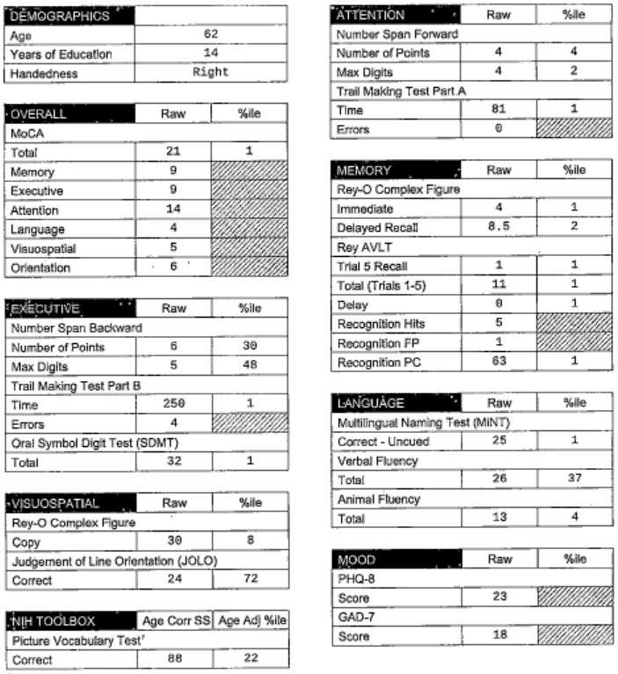
Neuropsych Testing Results

Slide 11
Exam
General: BMI 27, BP 156/76, appropriately dressed and groomed
Affect: cooperative, preserved insight, tearful
Mental Status: AAOx3, speech fluent, follows 2 step commands
Cranial Nerves: EOMI, face symmetric, hearing intact to conversation
Motor: 5/5 strength x 4, normal tone, no tremors
Coordination: No ataxia
Gait: Mildly unsteady but ambulates unassisted

Slide 12
Labs
B12 >1500
Thiamine 7 (normal 8-30)
TSH wnl
RPR non-reactive in 2017
HIV neg in 2020

Slide 13
MRI brain
FINDINGS:
Parenchyma: Brain volume is expected for age without an abnormal lobar pattern of volume loss. No infarction on DWI. No hemorrhage. No mass or mass effect. Scattered foci of T2 hyperintensity are present in the cerebral white matter that are nonspecific
but compatible with mild chronic microvascular ischemic changes. Cystic lesion measuring 3 mm in the posterior sella, may represent Rathke's cleft cyst.
Medial Temporal Atrophy:
Right: Normal (MTA 0)
Left: Normal (MTA 0)
Entorhinal Cortex Atrophy:
Right: Normal (ERiCA 0)
Left: Normal (ERiCA 0)
Extra-axial Collection: None
Ventricular System: Normal
Major Intracranial Flow Voids: Normal
Osseous Structures: Expected marrow signal.
Included Orbits: Bilateral lens replacement.
Paranasal Sinuses: Predominantly clear
Tympanomastoid Cavities: Normal
IMPRESSION: ​
1. No acute intracranial abnormality.​
​
2. Brain volume is expected for age without abnormal lobar pattern of volume loss.​
​
3. Scattered foci of T2 hyperintensity are present in the cerebral white matter that are nonspecific but compatible with mild chronic microvascular ischemic changes.

Slide 14
MRI (AX T2/FLAIR)

Slide 15
MRI (COR T1)

Slide 16
MRI (SAG T1)

Slide 17
MRI (GRE)

Slide 18
Possible Diagnoses
MCI vs mild dementia
Alzheimer's?
Radiology says no atrophy, but is there?
Impaired memory on NPT
Vascular?
Symptom onset after very small stroke in 2017
Minimal burden of chronic microvascular ischemic lesions
Mood disorder?
Significantly elevated scores on PHQ9 and GAD7
Self-reported low mood and impaired sleep
Impaired attention on NPT
Thiamine deficiency?
Side effect of amitriptyline?

Slide 19
Recommendations
LP for biomarkers?
Encourage to establish care with mental health care
Trial of donepezil? H/o of GI ulcer but unknown details.
Recheck thiamine level

